Slide 1
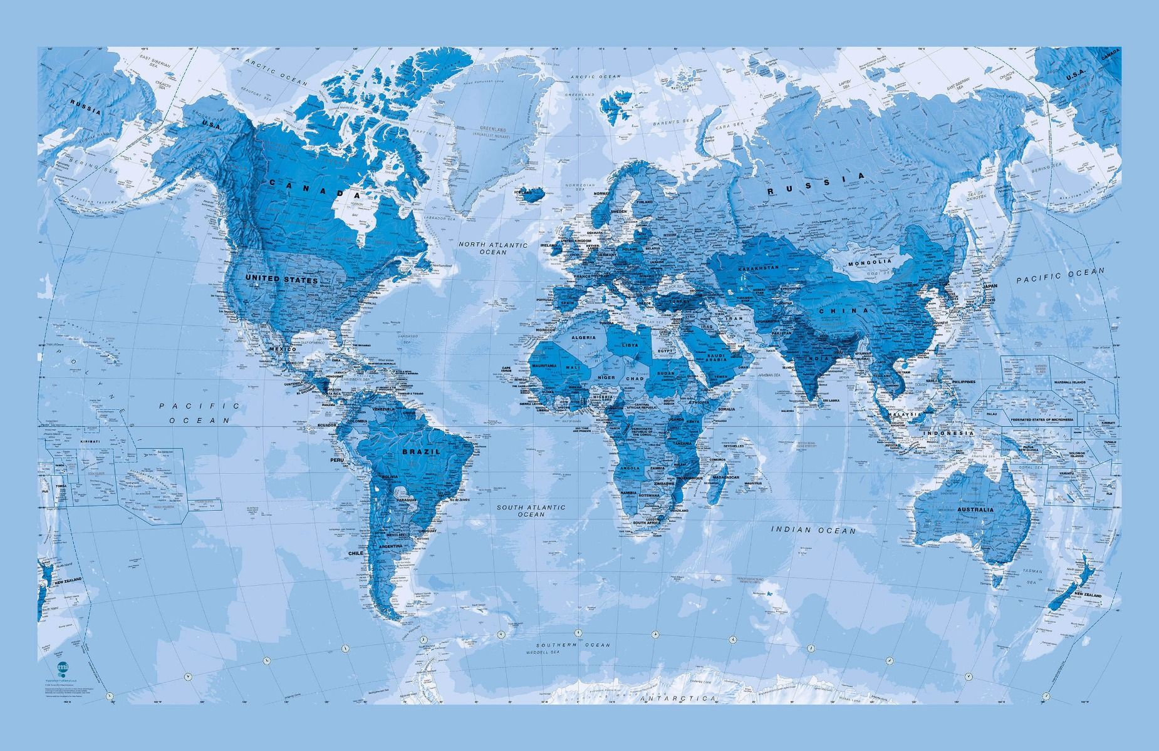

CWM Sunday Litany 2021
Rising to life with Christ
Stepping into Babylon in hope and power

Slide 2
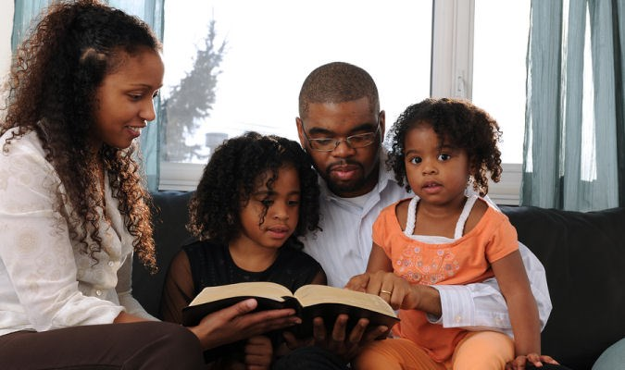
CWM has devised these worship resources to enable CWM member churches to share in worship which reflects on CWM Mission themes.
The resource should be adapted to need and context in your church’s order of service, be it words of response, or selection of worship songs. However, we hope the words and images provide a stir to consider how God comes to us in woe and wonder to show the new worlds God creates amongst us.

Slide 3
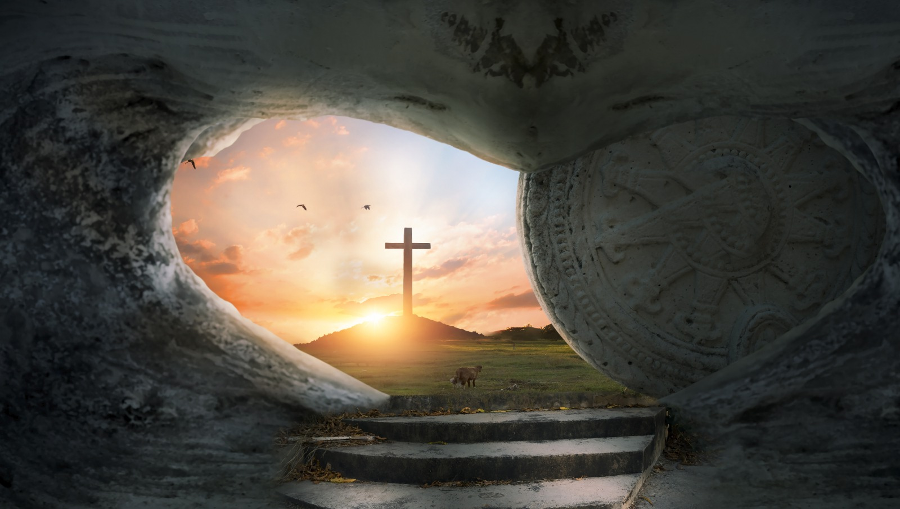
On days of celebration
Let us affirm our belief:
God loves life,
The tomb is empty
Christ is risen
On days of sickness
Let us affirm our bodies
God loves life,
Death is defeated
Christ is risen
On days of sorrow
Let us affirm our solace

Slide 4
God loves life,
Repentance creates change
Christ is risen
On days of struggle
Let us affirm our defiance:
God loves life,
Babylon is fallen
Christ is risen
Today and to each other
Let us affirm our hope:
God loves life,
Christ is risen
The New Creation is coming

Slide 5
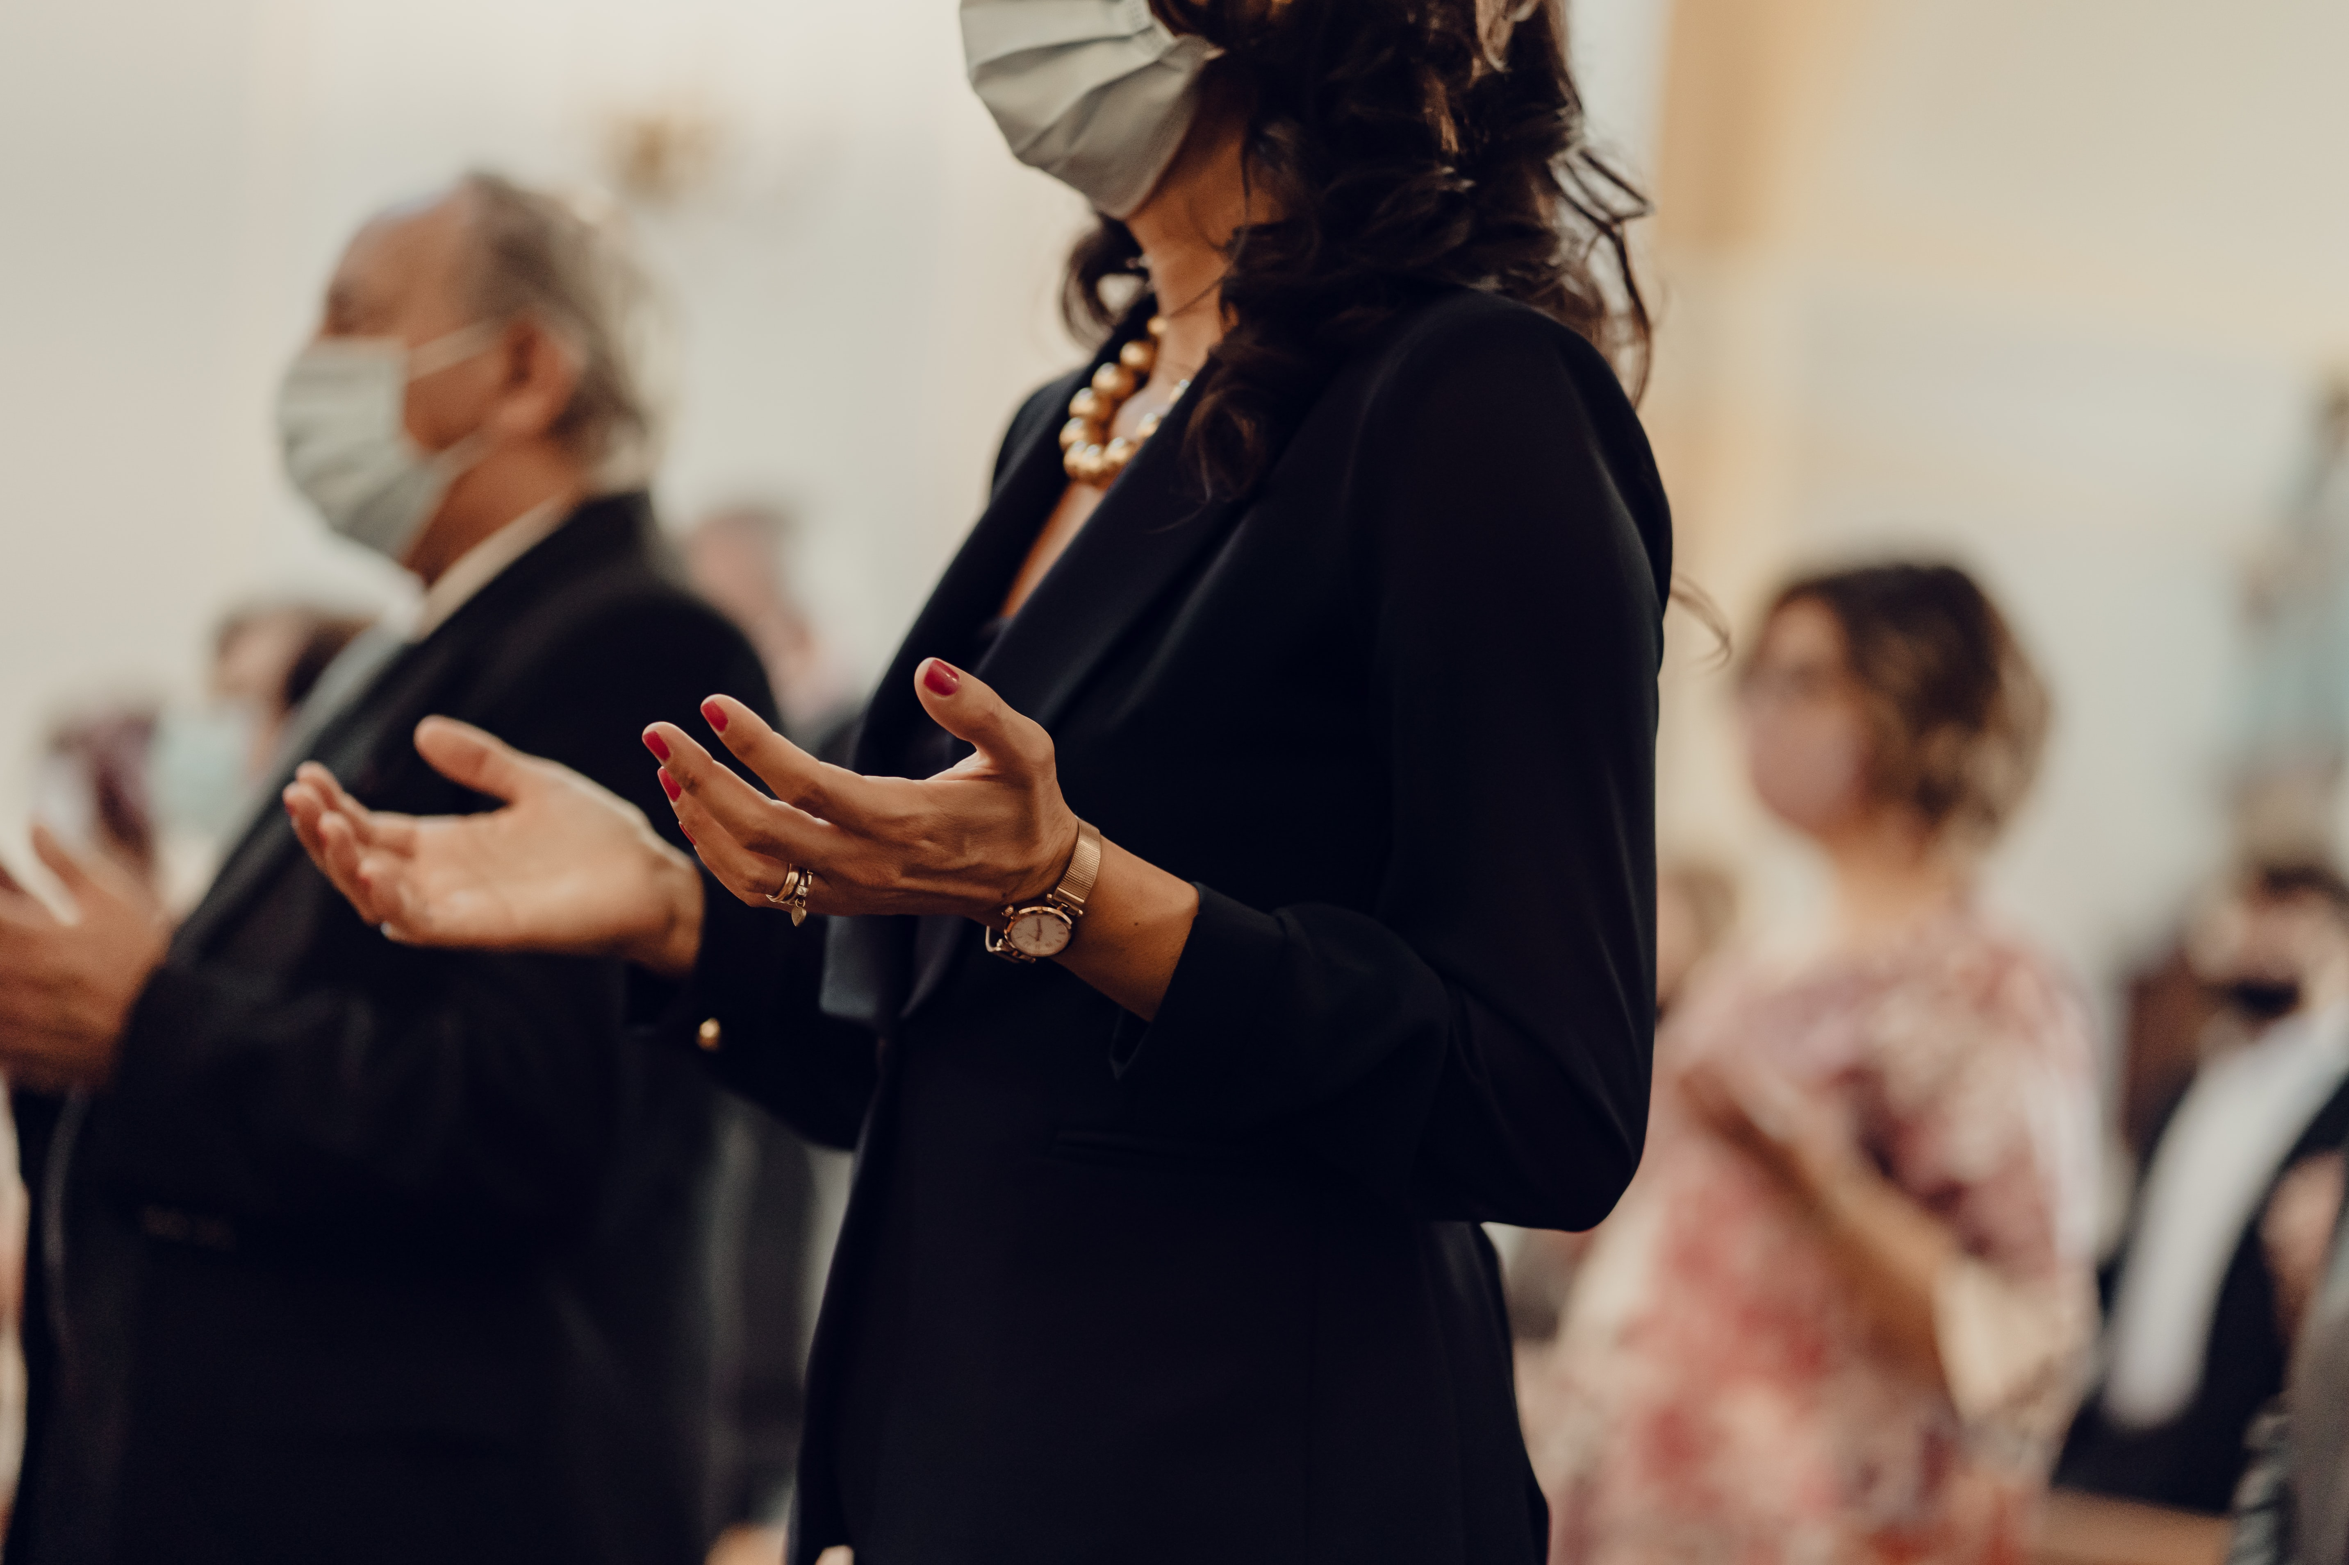
Song of response

Slide 6
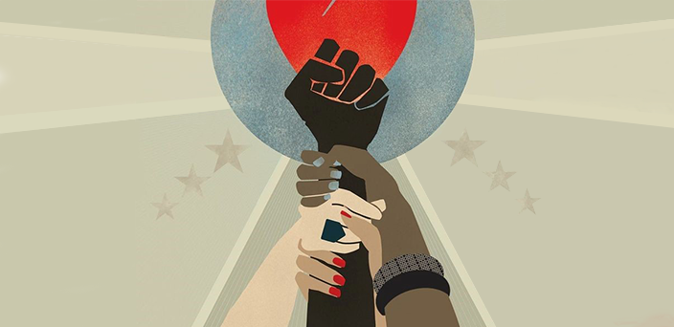
Reading Isaiah 21: 6 - 9
For thus the Lord said to me:
‘Go, post a lookout,
let him announce what he sees.
⁷ When he sees riders, horsemen in pairs,
riders on donkeys, riders on camels,
let him listen diligently,
very diligently.’

Slide 7
⁸ Then the watcher^{[a]} called out:
‘Upon a watch-tower I stand, O Lord,
continually by day,
and at my post I am stationed
throughout the night.
⁹ Look, there they come, riders,
horsemen in pairs!’
Then he responded,
‘Fallen, fallen is Babylon;
and all the images of her gods
lie shattered on the ground.’

Slide 8
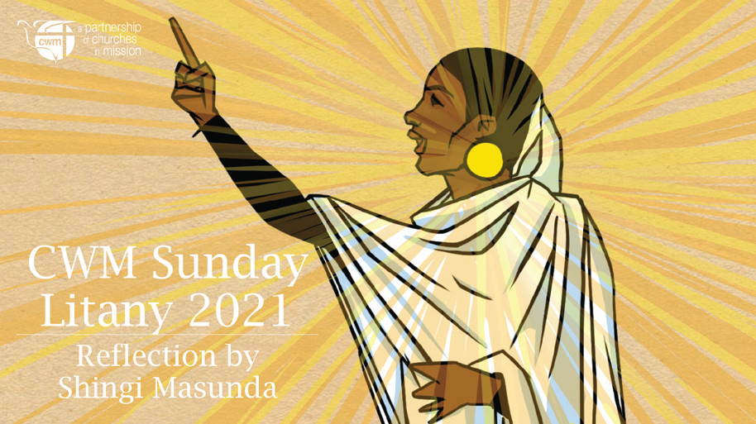


Slide 9
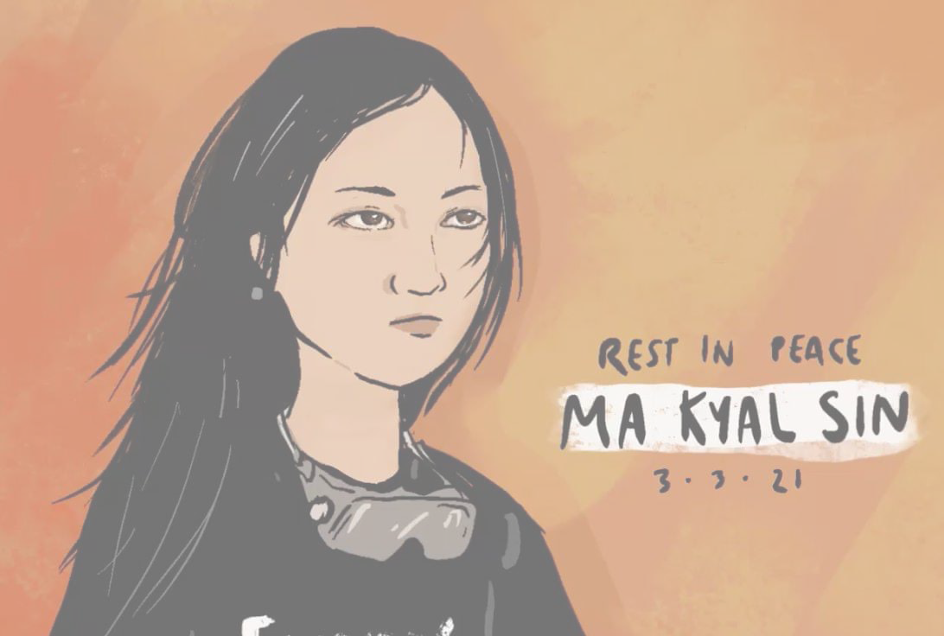
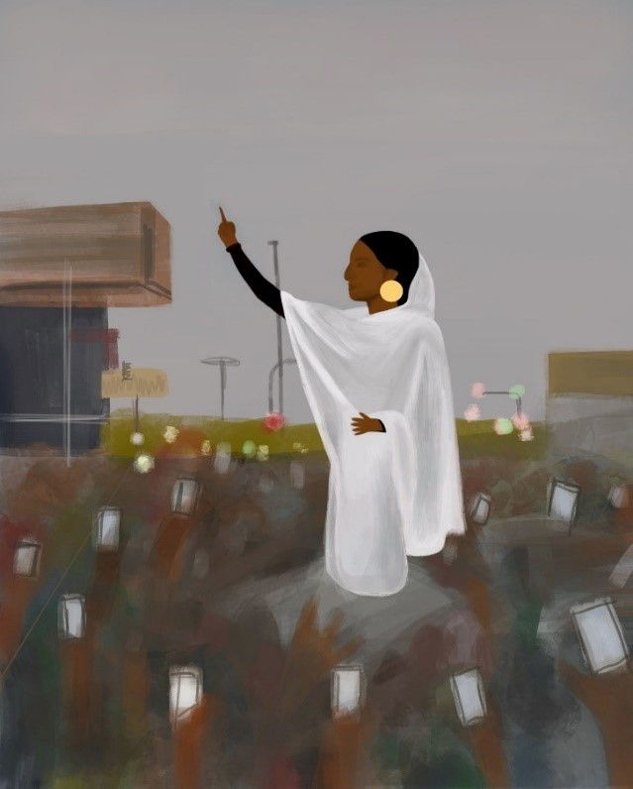
Reflection from the context or prerecorded reflections
‘Babylon’ names empire, oppression and judgement, in both Old and New Testament and in our life today. The opening reflection names Babylon in our midst, and especially points to and blesses those who risk bringing God’s counter world closer. This includes people like Ma Kyal Sin murdered in Myanmar and Alaa Salah, whose poetry helped inspire the popular rebellion against the Generals in Khartoum in 2019. These are the people who announce, like Isaiah’s watch keepers, that Babylon is fallen. They are reminders that the first people to witness to the resurrection were women.
A representation of Alaa Salah who was part of the popular uprisings in Sudan 2019

Slide 10
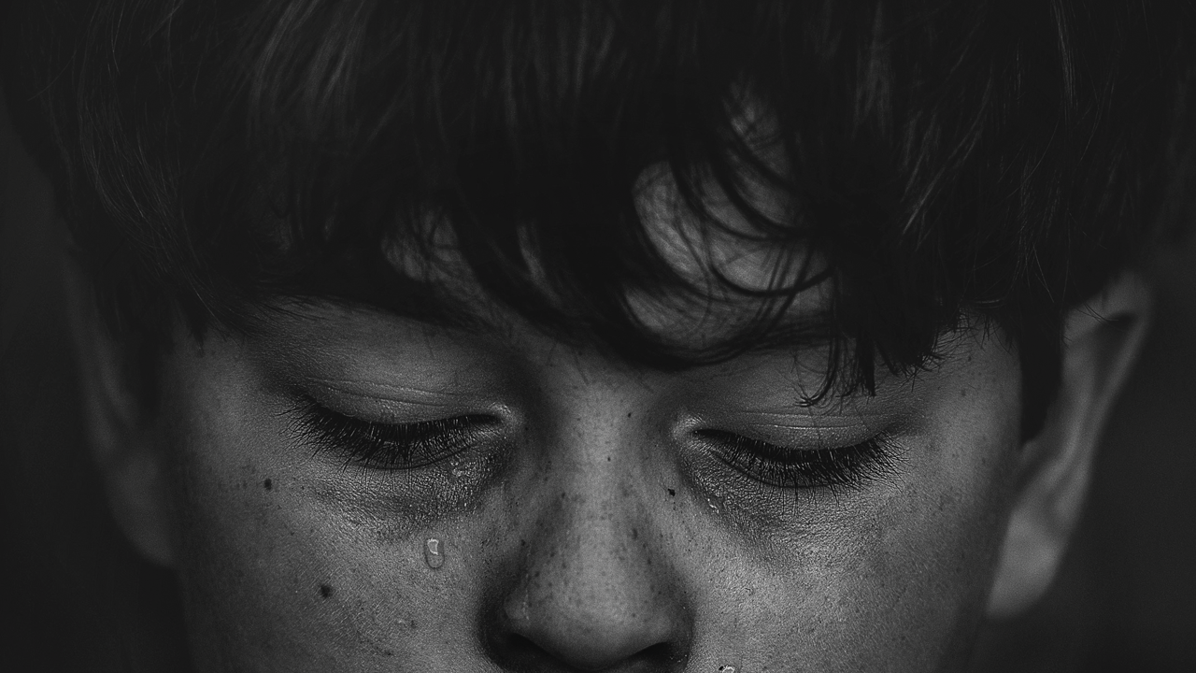
Response:
Creation is hurting
People are dying
The powerful are profiting
God is crying, God is calling!
Our divisions are power constructs for the benefit of the powerful
Christ’s coming was to transgress the boundaries and borders of human life
so that the New Heaven and Earth might come to subvert
all our maps and means and methods of living.

Slide 11
Let us rise up and proclaim in the face of Babylon that humanity is one
The earth is being despoiled for the profit of the few
Christ’s coming to raise up the lowly and bring down the wealthy
was to proclaim and honour the common wealth of the New Heaven and Earth.
Let us rise up and proclaim in the face of Babylon
that our economies must deliver life for all the community.

Slide 12
Song of Response

Slide 13
Reading Romans 8:19-23
For the creation waits with eager longing for the revealing of the children of God; ²⁰ for the creation was subjected to futility, not of its own will but by the will of the one who subjected it, in hope ²¹ that the creation itself will be set free from its bondage to decay and will obtain the freedom of the glory of the children of God. ²² We know that the whole creation has been groaning in labour pains until now; ²³ and not only the creation, but we ourselves, who have the first fruits of the Spirit, groan inwardly while we wait for adoption, the redemption of our bodies.

Slide 14
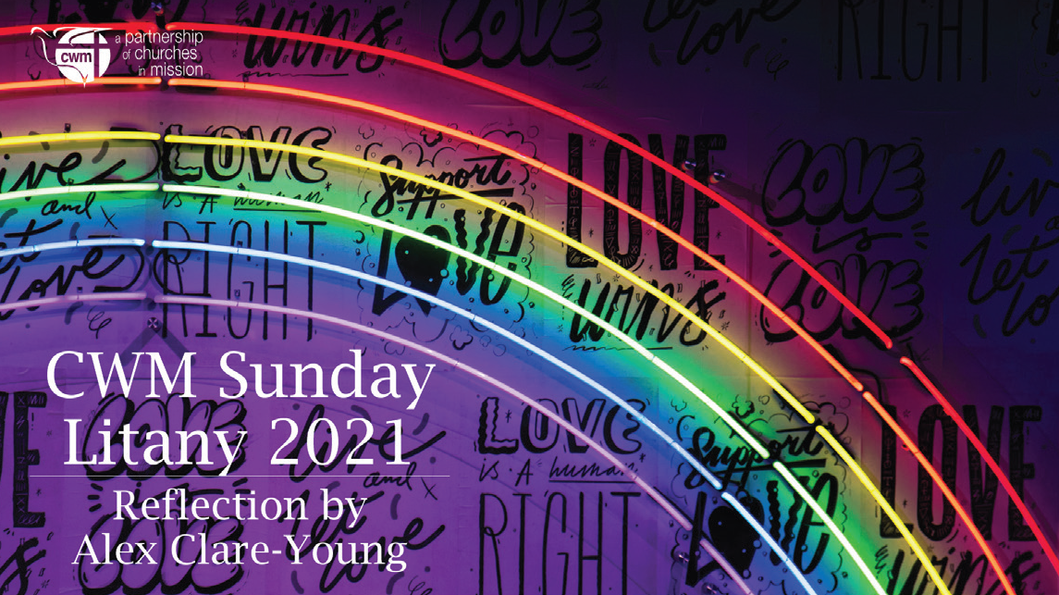

Slide 15
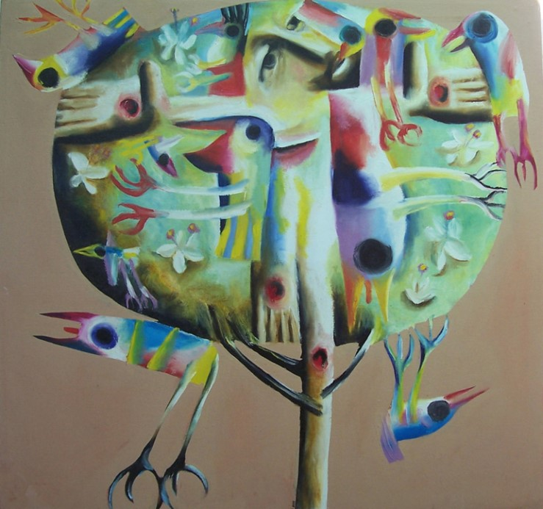
Reflection from the context or pre-recorded reflections
The reflection here may focus on the hubris of humanity which constructed a hierarchy of being, which has separated human beings from the rest of created life. This logic of hierarchy permits the ceaseless exploitation of the earth and drives the climate crisis we are now experiencing. This same logic has also permitted racism placing not simply humanity at the pinnacle of creation, but particular aspects of humanity like maleness and Whiteness especially.

Slide 16

This sin is endangering all of life and our work to repent, redeem and repair this sin is urgently required. This painting from an Aboriginal artist imagines the interconnection of life that resurrection does not break, but further blesses showing it is as fundamental to the new creation as to the old. Thus to live out the new creation now is to pull down the hierarchies Babylon has built.
‘Resurrection’
Nathan Simpson 1999
https://artandtheology.org/tag/nathan-simpson/

Slide 17
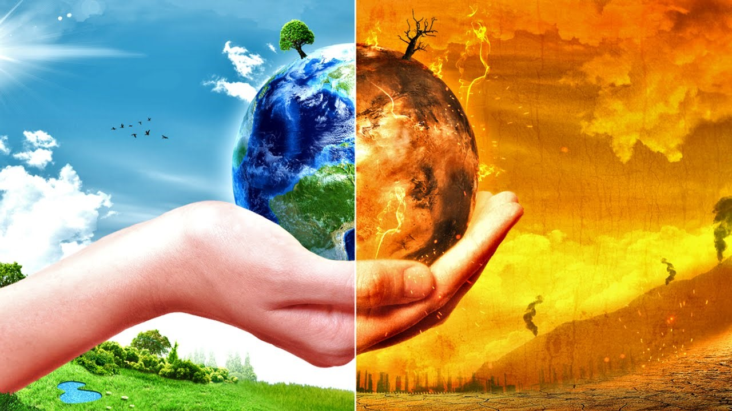
Response:
Creation is hurting
People are dying
The powerful are profiting
God is crying, God is calling!
Our systems are filled with hungers which harm and destroy
Christ’s coming to challenge Empire’s hierarchy of life
was to reveal that all created life is
dignified, affirmed, included and blessed
by God in the new Heaven and Earth she brings

Slide 18
Let us rise up and proclaim in the face of Babylon
that the last must be first,
those who want to be great must be the servants of all,
God wills newness of life for all of life.

Slide 19
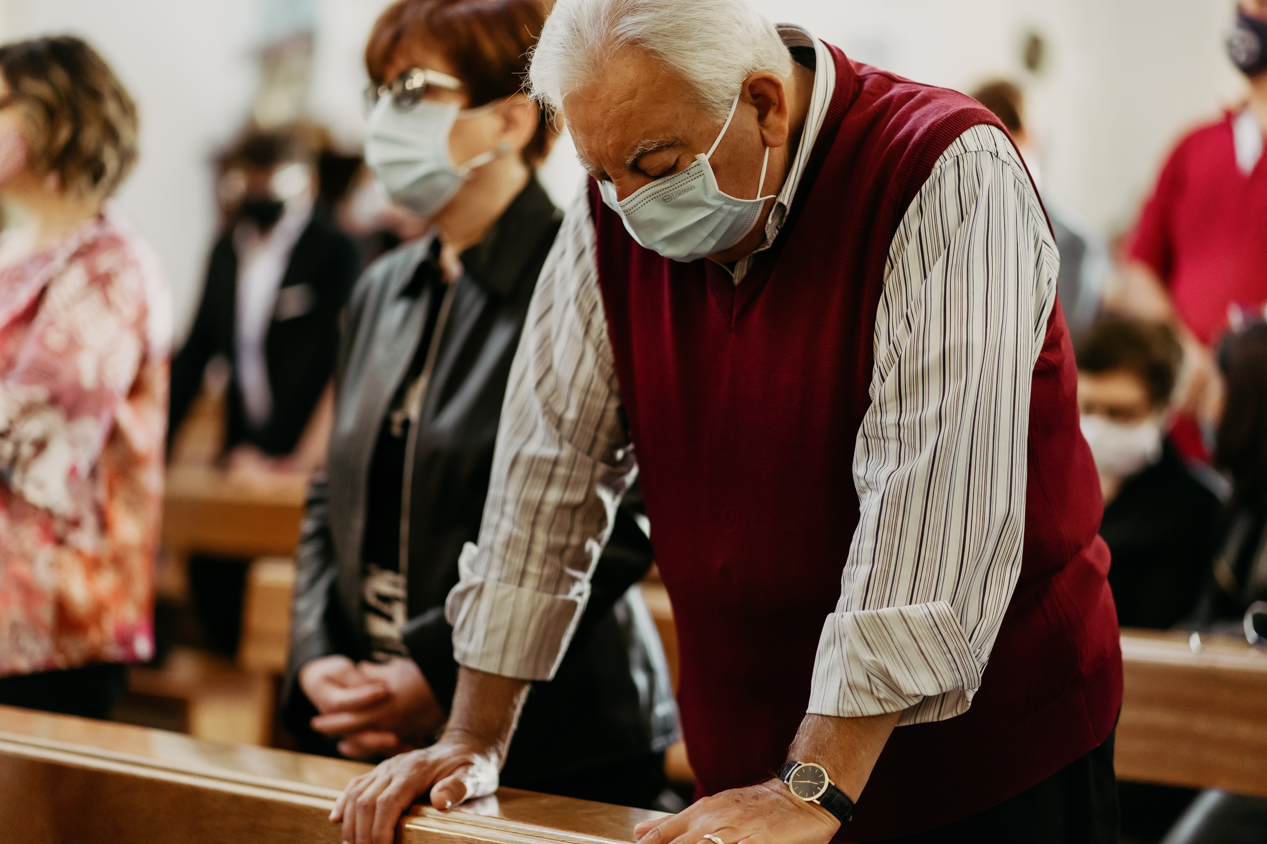
Song of response

Slide 20
Reading Isaiah 41:17 - 20
When the poor and needy seek water,
and there is none,
and their tongue is parched with thirst,
I the Lord will answer them,
I the God of Israel will not forsake them.
¹⁸ I will open rivers on the bare heights,
and fountains in the midst of the valleys;
I will make the wilderness a pool of water,
and the dry land springs of water.

Slide 21
¹⁹ I will put in the wilderness the cedar,
the acacia, the myrtle, and the olive;
I will set in the desert the cypress,
the plane and the pine together,
²⁰ so that all may see and know,
all may consider and understand,
that the hand of the Lord has done this,
the Holy One of Israel has created it.

Slide 22
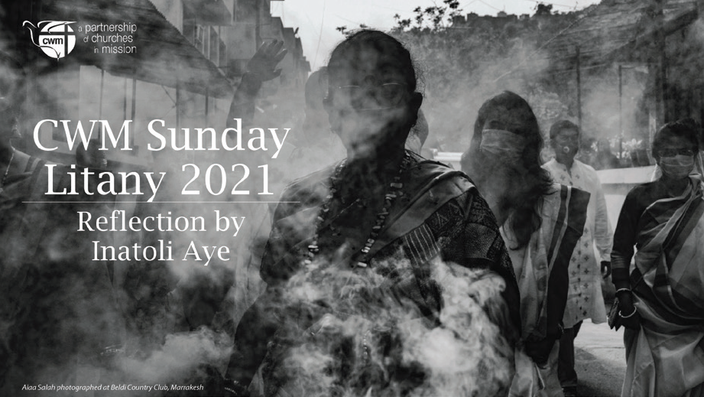

Slide 23
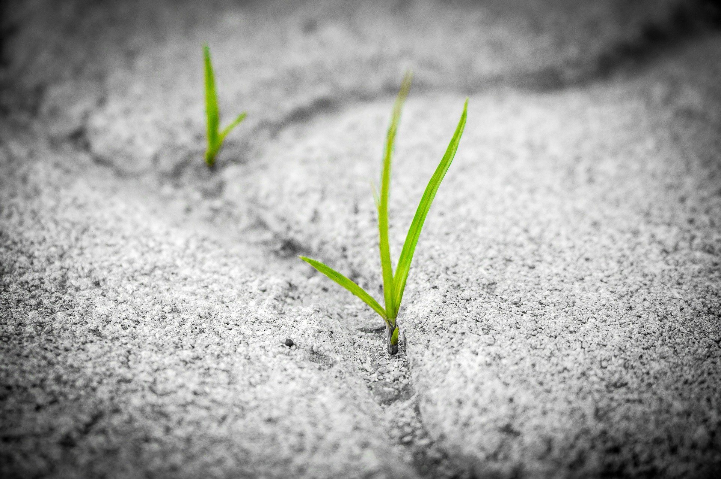
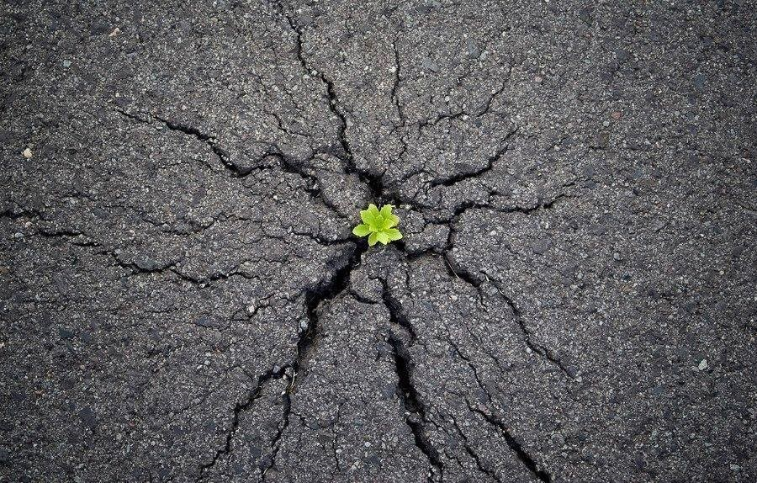
Reflection from context or prerecorded reflections
We cannot underestimate the struggle before us in announcing that Babylon is as fallen as the tomb is empty. This image like the text reminds us not to despair, that in the concrete of Babylon, the new creation breaks forth.

Slide 24
It breaks out from below of course so we need to consider where we should look for signs of God’s counter creation. And because it is a creation counter to ours, we are also in danger of tearing up God’s new creation because we want to preserve the order of the old. Our work then is as gardeners tending the new world God has sown amongst us.

Slide 25
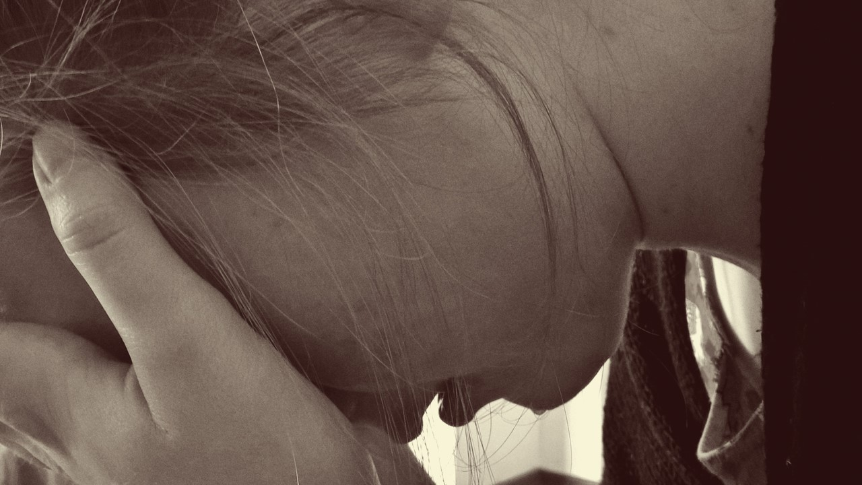
Response:
Creation is hurting
People are dying
The powerful are profiting
God is crying, God is calling!
Let us rise up and proclaim in the face of Covid
and all that makes us sick from Babylon
that we can no longer live in ways
which destroy the earth,
that Christ’s coming was to show God so loved the world
that all the world’s lives would be gathered up
in the promise of the New Heaven and Earth.

Slide 26
God amongst the vulnerable, and the exploited,
God with the uprising movements,
God within the aching polluted earth,
God beyond the confines of Babylon,
You call us to repent and change
and seek ways of living in which
life flourishes, justice grows and peace takes hold.

Slide 27
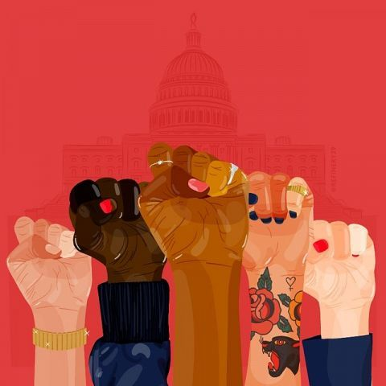
Song of uprising
Hugh Masekela Send me
I wanna be there when the people start to turn it around
When they triumph over poverty
I wanna be there when the people win the battle against AIDS
I wanna lend a hand
I wanna be there for the alcoholic
I wanna be there for the drug addict
I wanna be there for the victims of violence and abuse
I wanna lend a hand
Send me

Slide 28
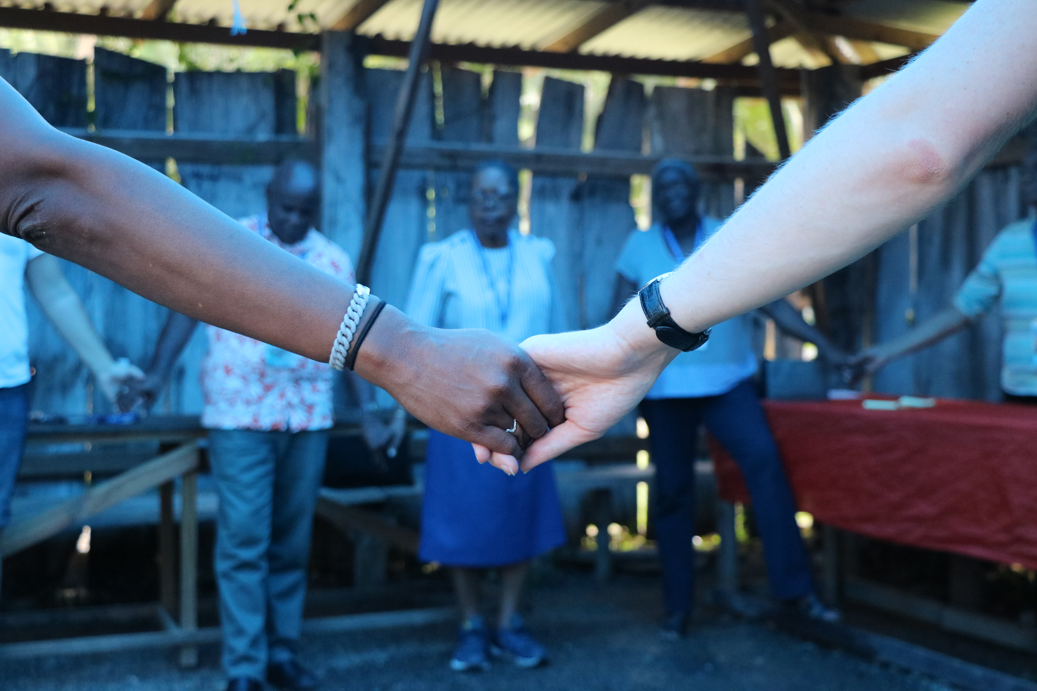
CWM commissioning prayer
We call on each other, in Christ’s name, to root this vision of life flourishing communities in our communities, contexts and make clear our witness to Christ in the changes we seek to bring in the midst of the crises our world faces.
Christ has left behind him the tombs of Babylon and stepped forth into the first day of the New Heaven and Earth. He bids us follow, to come together as communities which show how life can flourish still. We confess and pledge that we are Christ’s disciples and we will embody in our work and witness that we are arising, shining, planting, praying, singing and dancing the alternatives to Babylon’s death and destruction.

Slide 29
Creation is hurting
People are dying
The powerful are profiting
God is crying, God is calling!
Rise up! Proclaim that Babylon has fallen!
In word and world we hear you cry: ARISE!
The light of the world has come: SO LET US SHINE
We lift up our eyes: TO SEE YOUR NEW WORLD COMING
And in doing justice: PROCLAIM THE PRAISE OF THE LORD
And so, we pray,
counter in and through us
systems of despair and dread
WITH SIGNS OF LOVE AND PEACE

Slide 30
And so, we pray,
counter in and through us
systems of hatred and death
WITH LIVES FILLED WITH LOVE AND DEFIANCE
And so, we pray,
counter in and through us
systems of division and oblivion
WITH MOVEMENTS OF JOY AND TRANSFORMATION

Slide 31
Song of Response

