Slide 1


CWM SUNDAY 2022
Rising to Life in the midst of multiple displacements and trauma

Slide 2
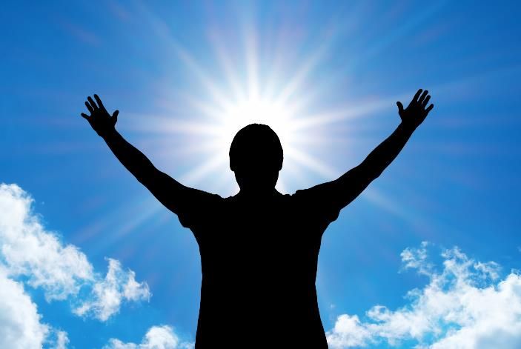
Worship is at the heart of our missional vocation. On this CWM 45th Anniversary Sunday, we have crafted worship resources to enable member churches to participate in worship which reflects on CWM Mission themes.
The resource which is offered here should be adapted to need and context. At the same time, we hope the words and images provide inspiration and motivation to consider how God comes to us in woe and wonder to show the new worlds God creates amongst us.

Slide 3
The theme 'displacement and trauma' highlights the reality of many contexts around the word.
The war in Ukraine,
the ongoing Israeli-Palestinian conflict,
the military occupation of Myanmar,
the millions of people who flock the USA borders from South America,
the continuing instability of Haiti,
the African emigration by the millions to Europe, the many Pacific Islanders fleeing low lying atolls due to sea level rise,
the displacement of life due to over-exploitation and extraction of natural resources and an economic system that privileges the rich,
the displacement of trust in politics,
and many more dis/mis-placement of life,
is the reality of our world today...

Slide 4
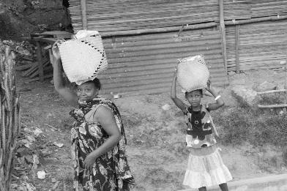
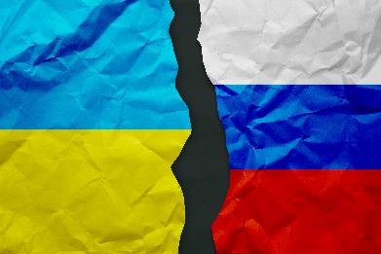
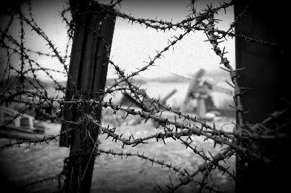
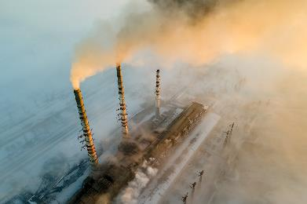
CWM Sunday follows the tradition of inviting its member churches to join in worship, reflecting on ‘Displacement and Trauma’ in the light of CWM overarching theme of Rising to Life.
This liturgy is prepared in a way that will invite various contexts to find roots that could connect them to others and their realities. It is also prepared in the context of CWM celebrating 45 years!

Slide 5


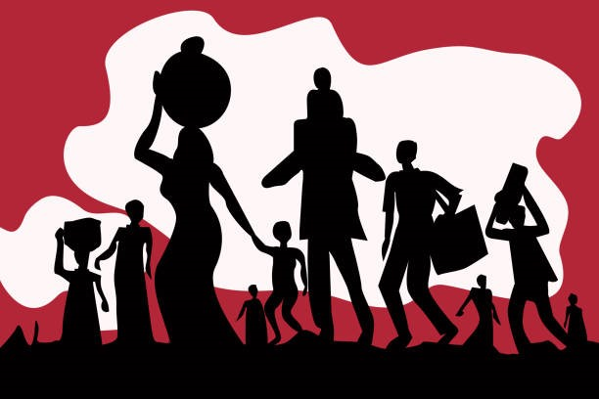
Welcoming note and Overview of CWM Sunday
A pre-recorded greeting and reflection from
GS Rev Dr Jooseop Keum
Deuteronomy 10:18
“He defends the cause of the fatherless and the widow, and loves the foreigner residing among you, giving them food and clothing”

Slide 6
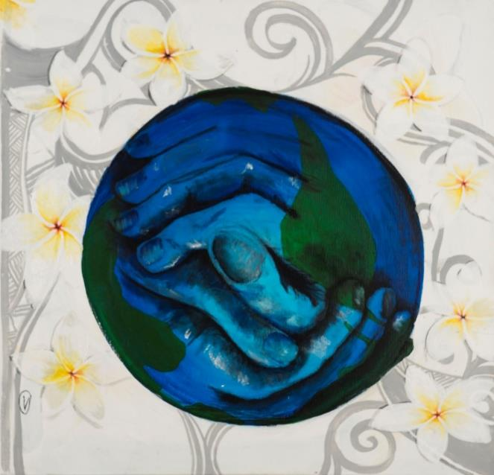
Gathering Words
All: God you are our refuge
One: You are the shore in sight,
you are the hands that reach out,
you are the ground on which to rest
All: God you are our strength
One: You are the life we long for,
you are the refusal to give up,
you are the keys of home we carry with us
All: God you are help in time of trouble
One: we call on you from the ruins and the rubble,
we call on you from the wildness and the deep
All: We call on you to meet us in this place
Tomasi Domomate,
Inclusive community, Fiji, 2016

Slide 7
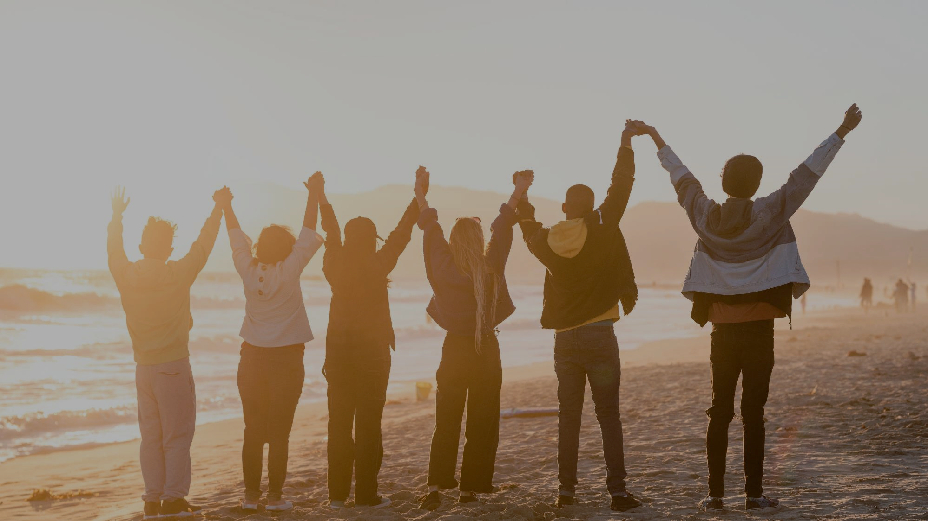
Praying thanks
[can be read/said in parts by three voices alternating, pausing for silent contemplation after each petition]
For our life together as a CWM family
for all those who have given and received much in the life of CWM
for hearing God’s call and responding to the cries of the oppressed
for a commitment to remain bold, daring and steadfast in a world of injustices and empires
for the commitment and daringness to walk and practice the way of abundant life for all
for tears, water of life that runs down our faces and connect our lives

Slide 8

Praying thanks
for the burden of God’s creation
for the spirit of solidarity
for when we are welcomed
for the hospitality of indigent people
for God’s goodness running through natural resources
for the ability to listen to wounded people

Slide 9

Praying thanks
for the chance to becoming better humans
for the activists, community workers, and prophets who give their lives, gifts and labour to the people of the world
for being together here
for the noise of children
for the spirit of resistance and rebellious people
for clean water

Slide 10
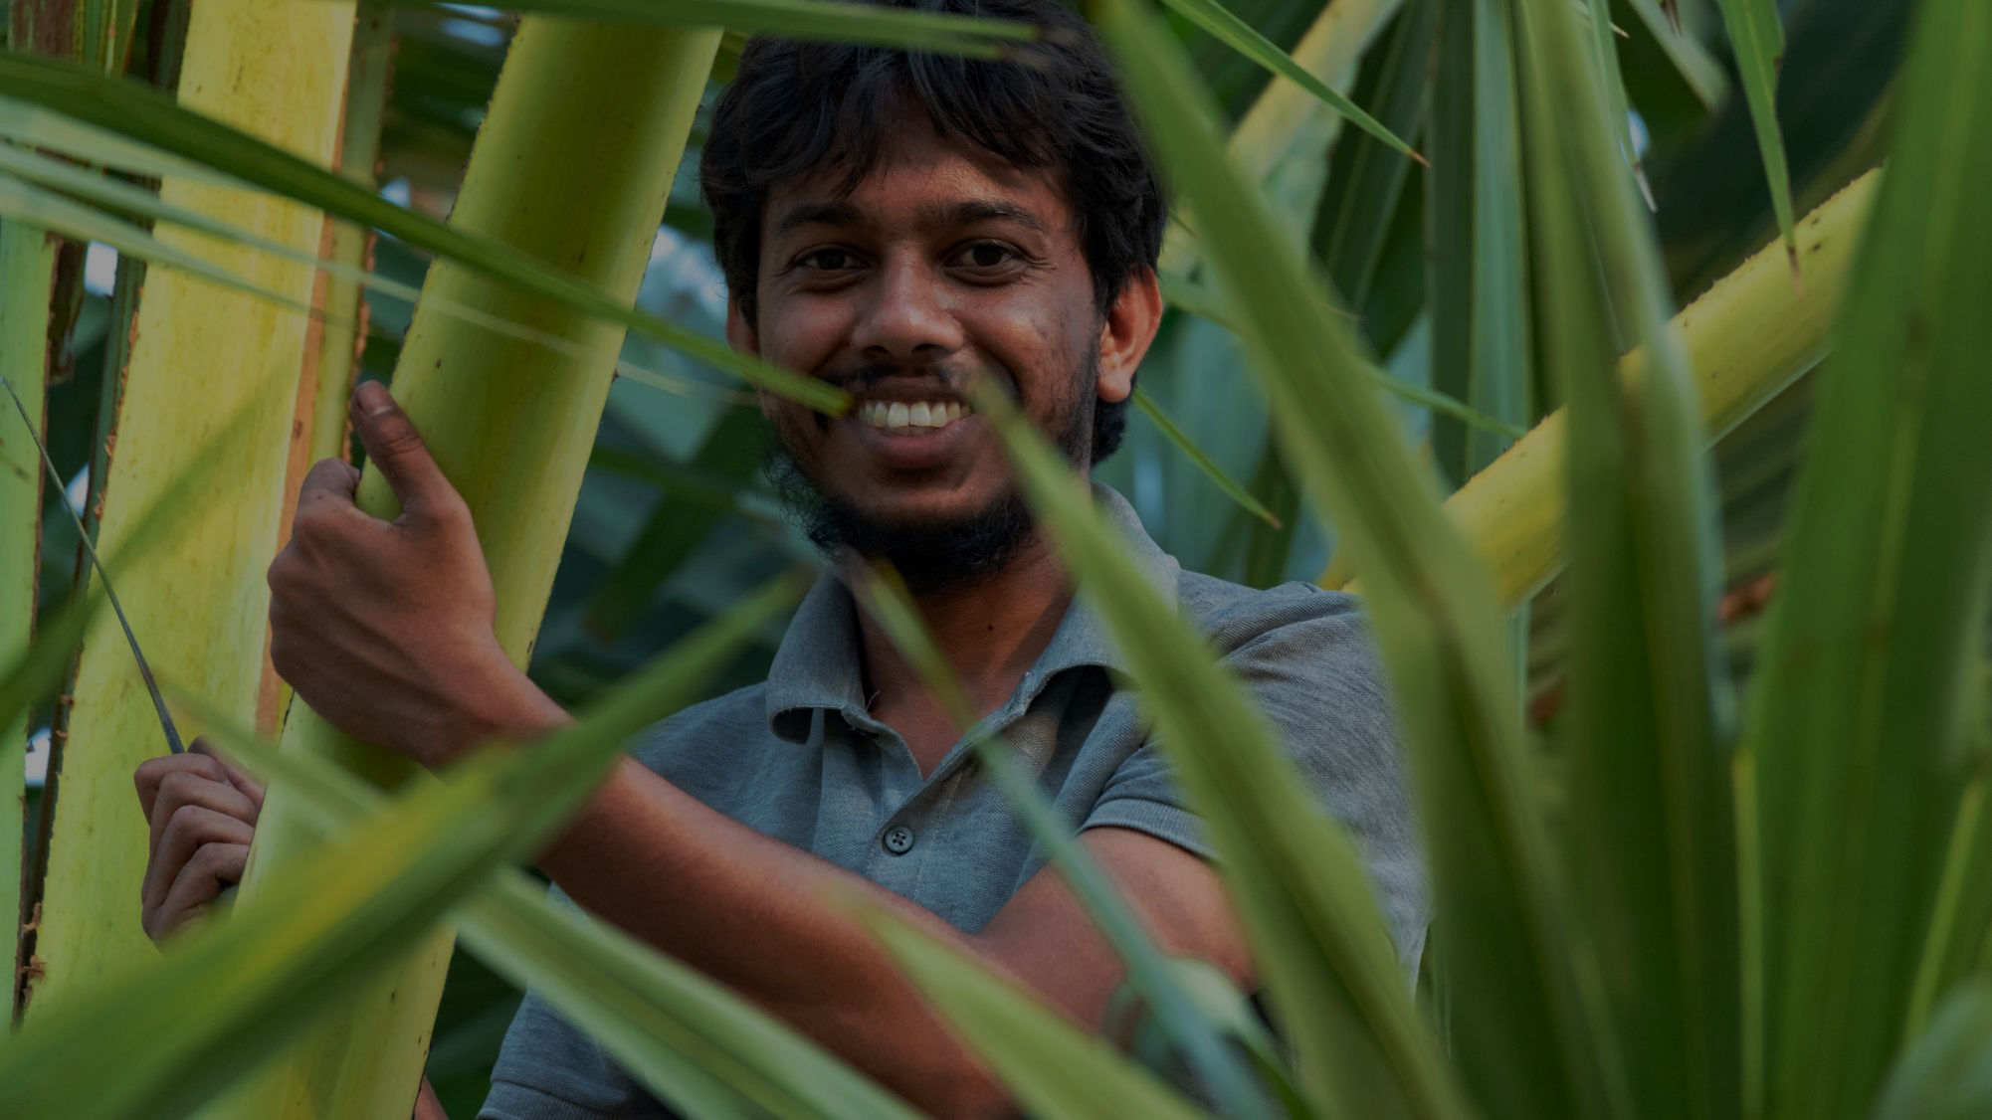

Praying thanks
for strength and courage to live on in spite of loss
for the gift of the others, the families with whom we live
for maternal rage
from hope that comes from smiles and laughter
for generosity that has enabled us to reach far beyond the CWM family with the word and witness of the of the gospel of full and flourishing life for all
All: for these and much more we give thanks to our rising-up God who accompanies us!

Slide 11
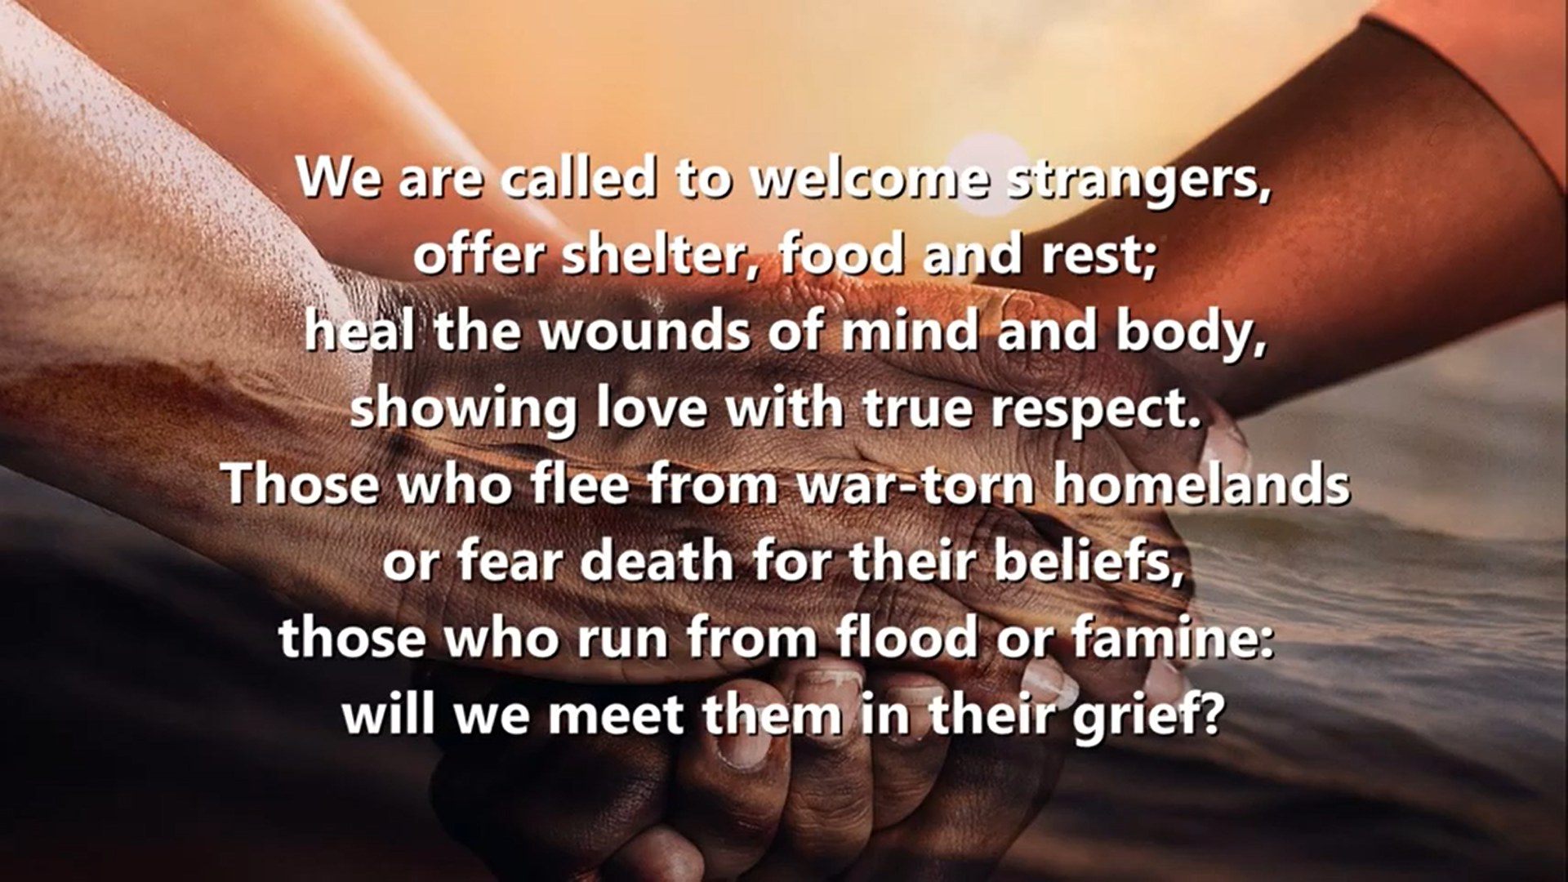
Community Singing
'We are called to welcome Strangers'
Or a relevant song/hymn for your context

Slide 12
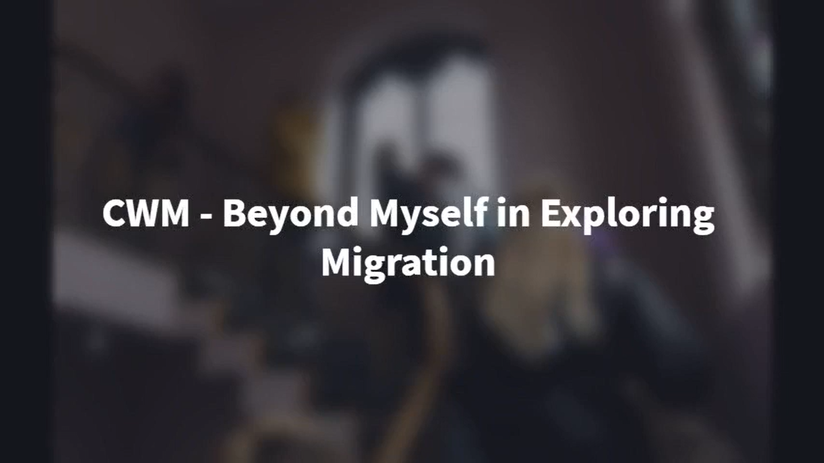
Interrupting our flow
Here's a Short Video Clip from CWM's collection related to displacement and rising to life may be used

Slide 13
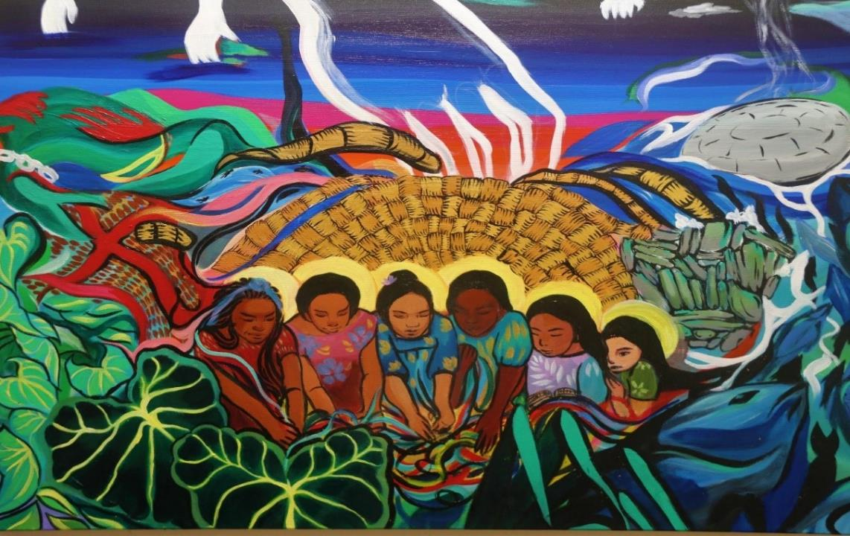
Litany of and for Land
Malia Vaurasi, Hands of Resistance, Fiji, 2021

Slide 14
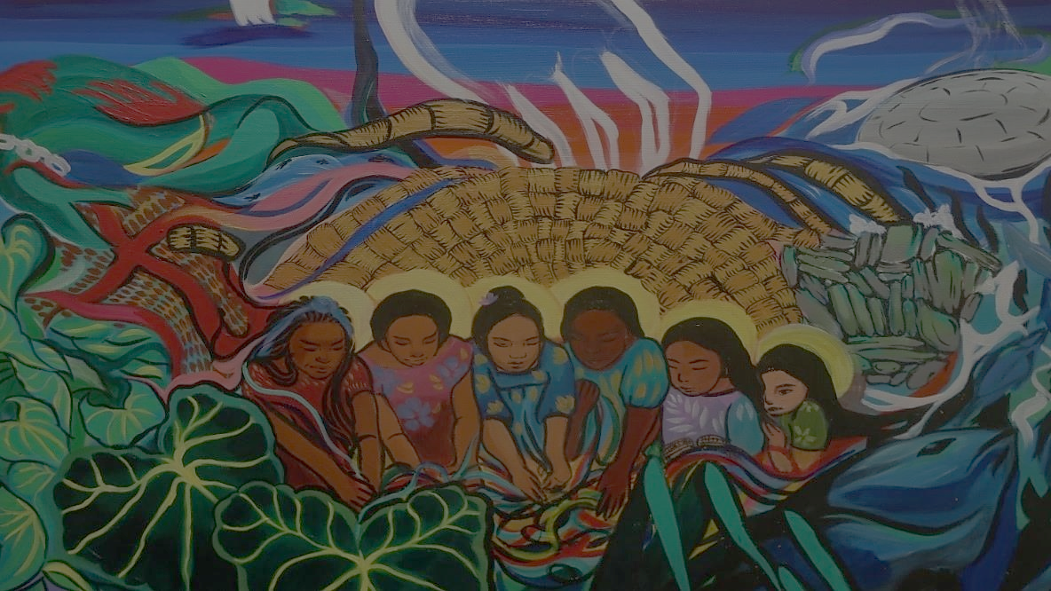
Litany of and for Land
All: Birthed out of the bosom of God, we are also children of the land.
One: Land is a gift; home is where life is first experienced
All: Sent forth from the bosom of God, we find our identity in the land
One: Land is our identity; home is where life is first experienced
All: We live in the land, we life off the land, we have our roots in the land.
One: But we have been forcefully removed from the land.
Now we are wonderers, landless and homeless.
All: This land is not ours. We are strangers in this land.
One: Who will welcome us?
Who will home us?
Who will call us one of their own?
All: God of the land,
One: Bring us once again into your bosom, where life was first experienced.

Slide 15

Scripture Reading
Zechariah 7: 8 – 10
⁸ And the word of the Lord came again to Zechariah: ⁹ “This is what the Lord Almighty said: ‘Administer true justice; show mercy and compassion to one another. ¹⁰ Do not oppress the widow or the fatherless, the foreigner or the poor. Do not plot evil against each other.’
Reflection on the above text
(member churches are invited to find and work their way through the text)

Slide 16
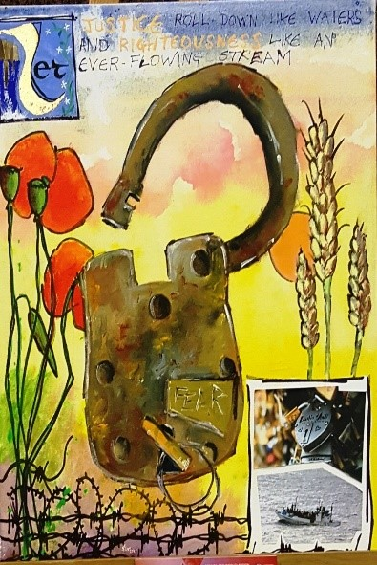
An act of renouncing and affirmation
In solidarity and in the spirit of the Rising-up one, let us make our commitment to work for the release of all people, working towards the restoring of creation and advocating against all that stand in the way of full and flourishing life for all

Slide 17
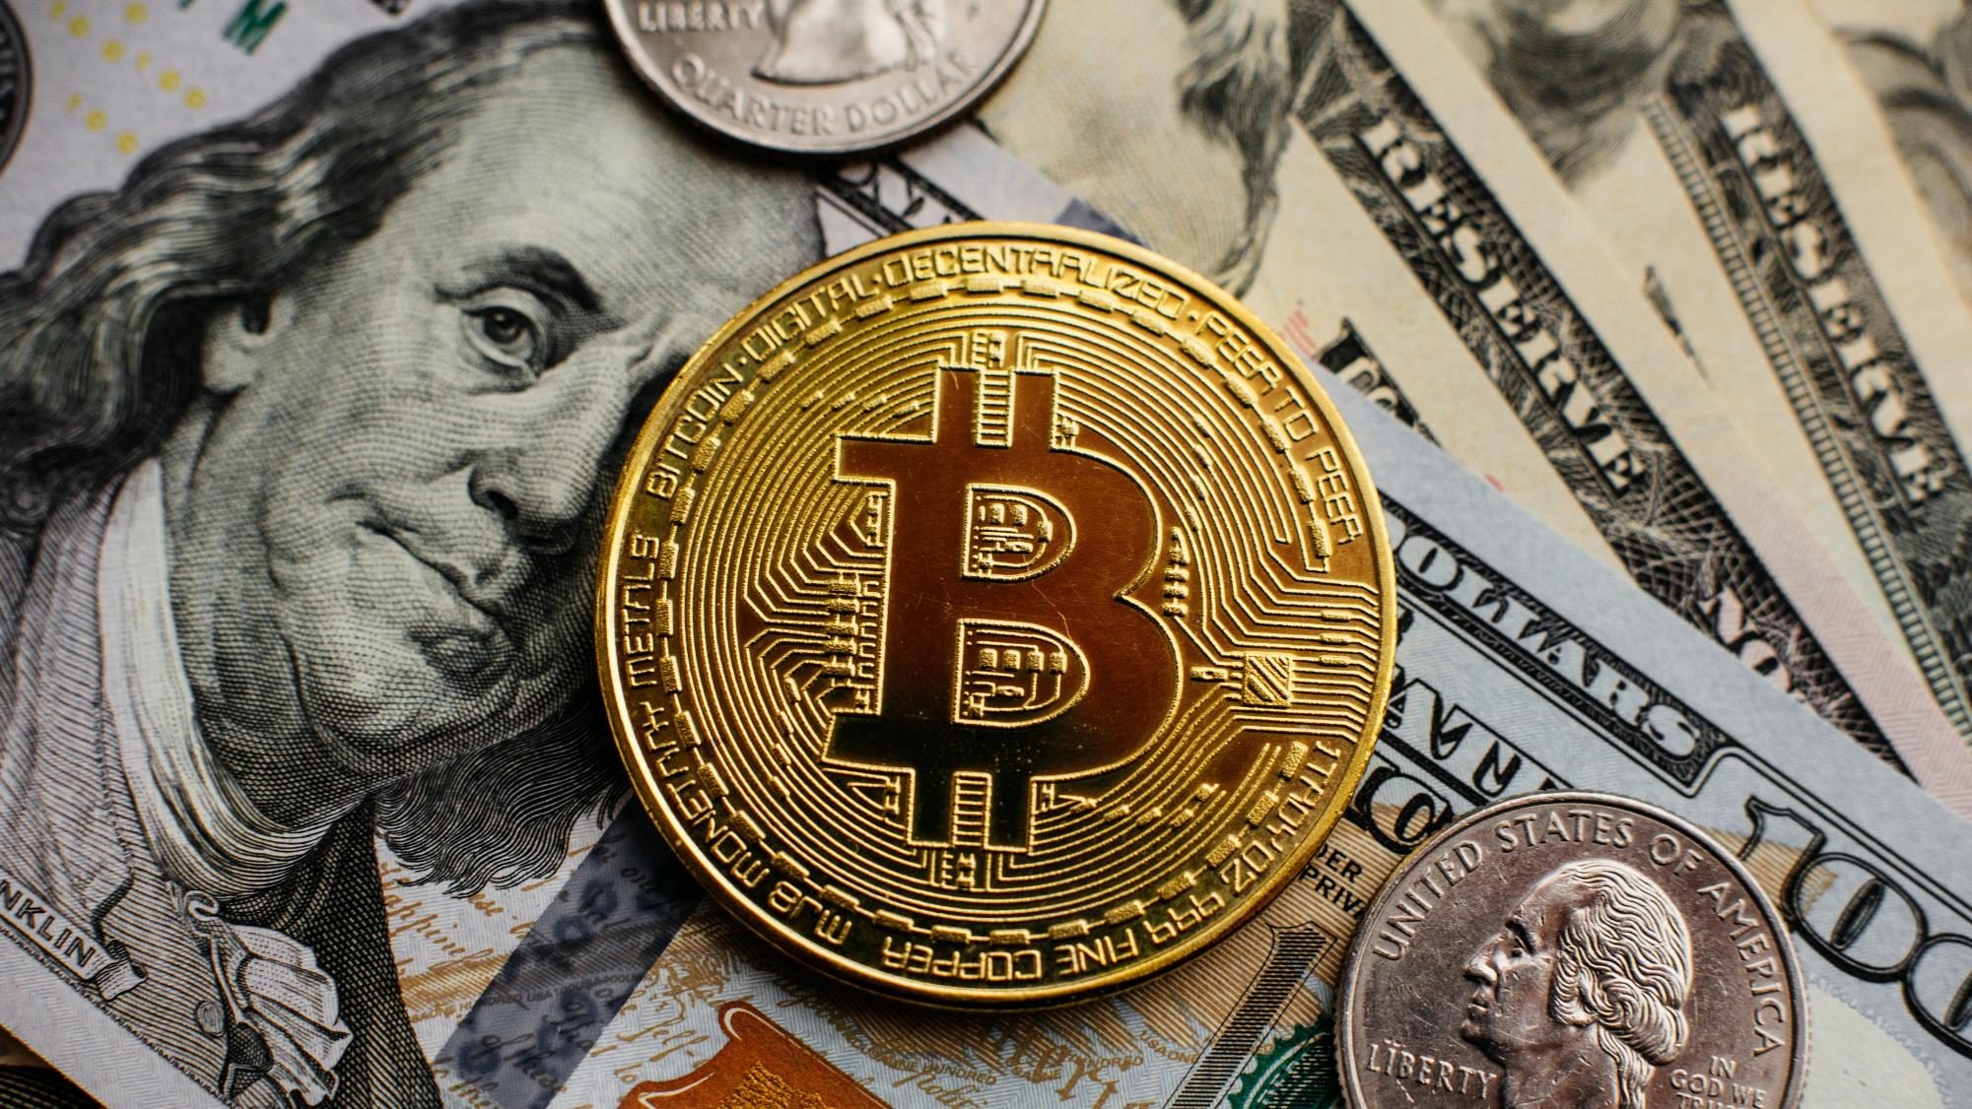
An act of renouncing and affirmation
Do you renounce greed, the love of wealth, and the empty promises of a failing economic system?
We renounce them!
Do you renounce an economic system structured for the benefit of the elite and a few while the majority lives in penury?
We renounce them!
Do you renounce oppression and all the forces that keep us from living liberated lives and working for the liberation of all?
We renounce them!

Slide 18
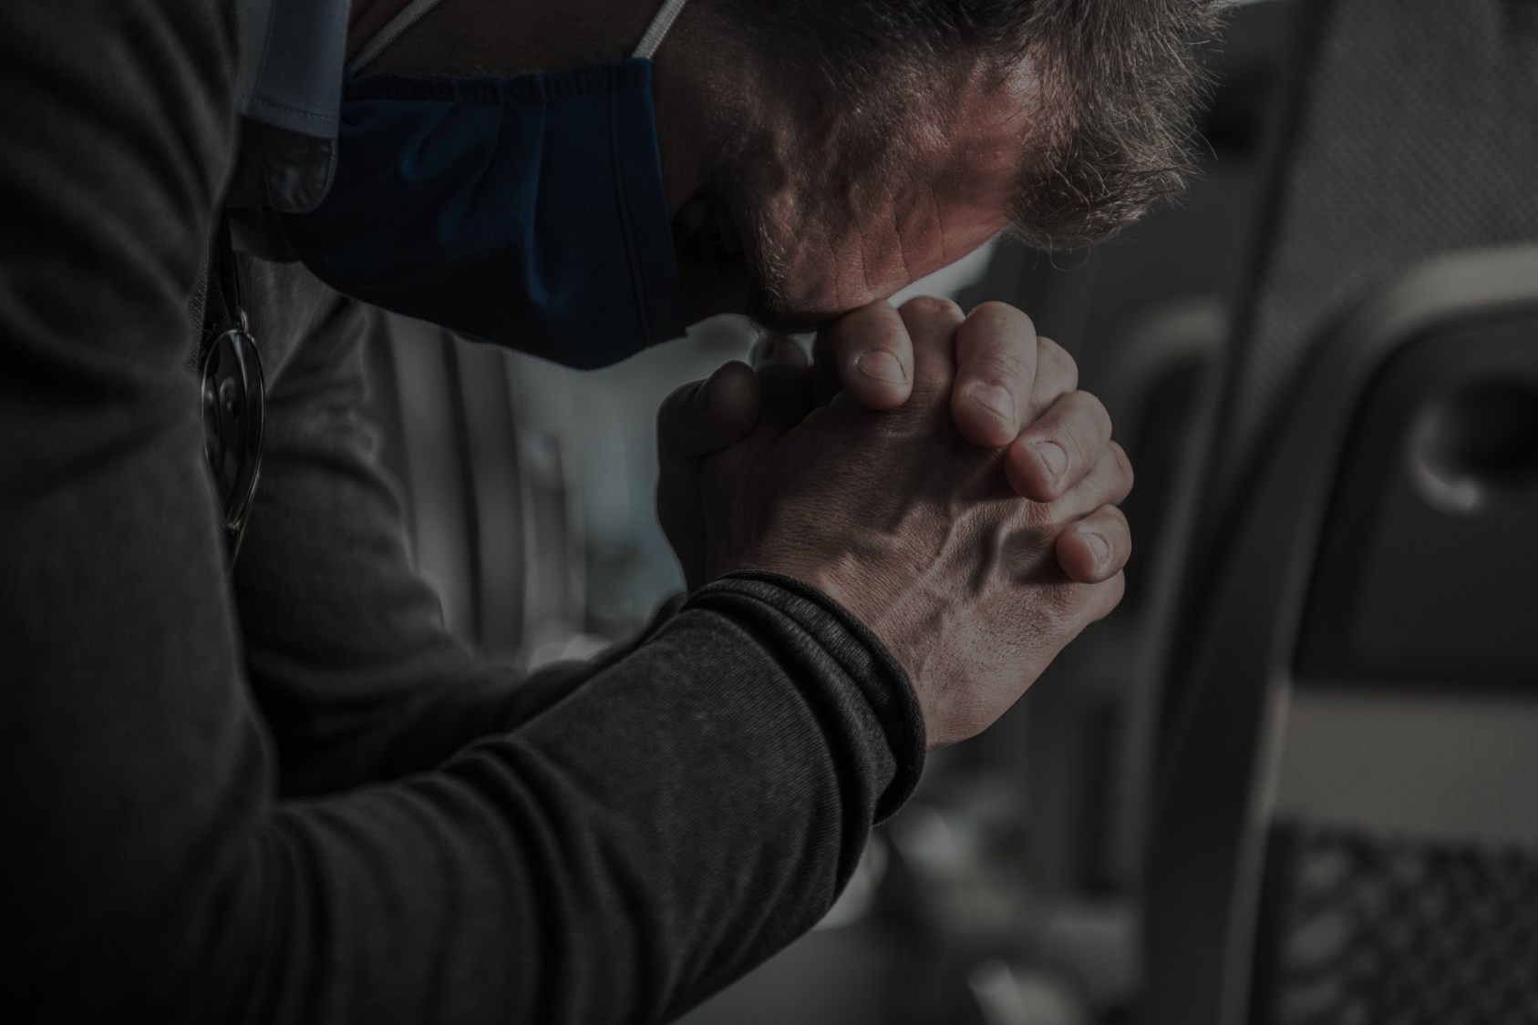
An act of renouncing and affirmation
Do you renounce the fear that dwells in you, all its alluring securities – those things that draw you away from confronting your own oppression, loving your own neighbour, and building power for the sake of a liberated world?
We renounce them!
Do you renounce all that create walls, divide, estrange, displace, marginalise and deny the humanity in each of us?
We renounce them!

Slide 19

An act of renouncing and affirmation
Do you renounce the destruction of the earth and its resources, the devaluation of nature, and the denial of climate change, as the planet is sacrificed for human greed, leading to pending and unimaginable calamity?
We renounce them!
With your heart, soul, strength and mind do you renounce all these?
We renounce them
We renounce them
We renounce them

Slide 20
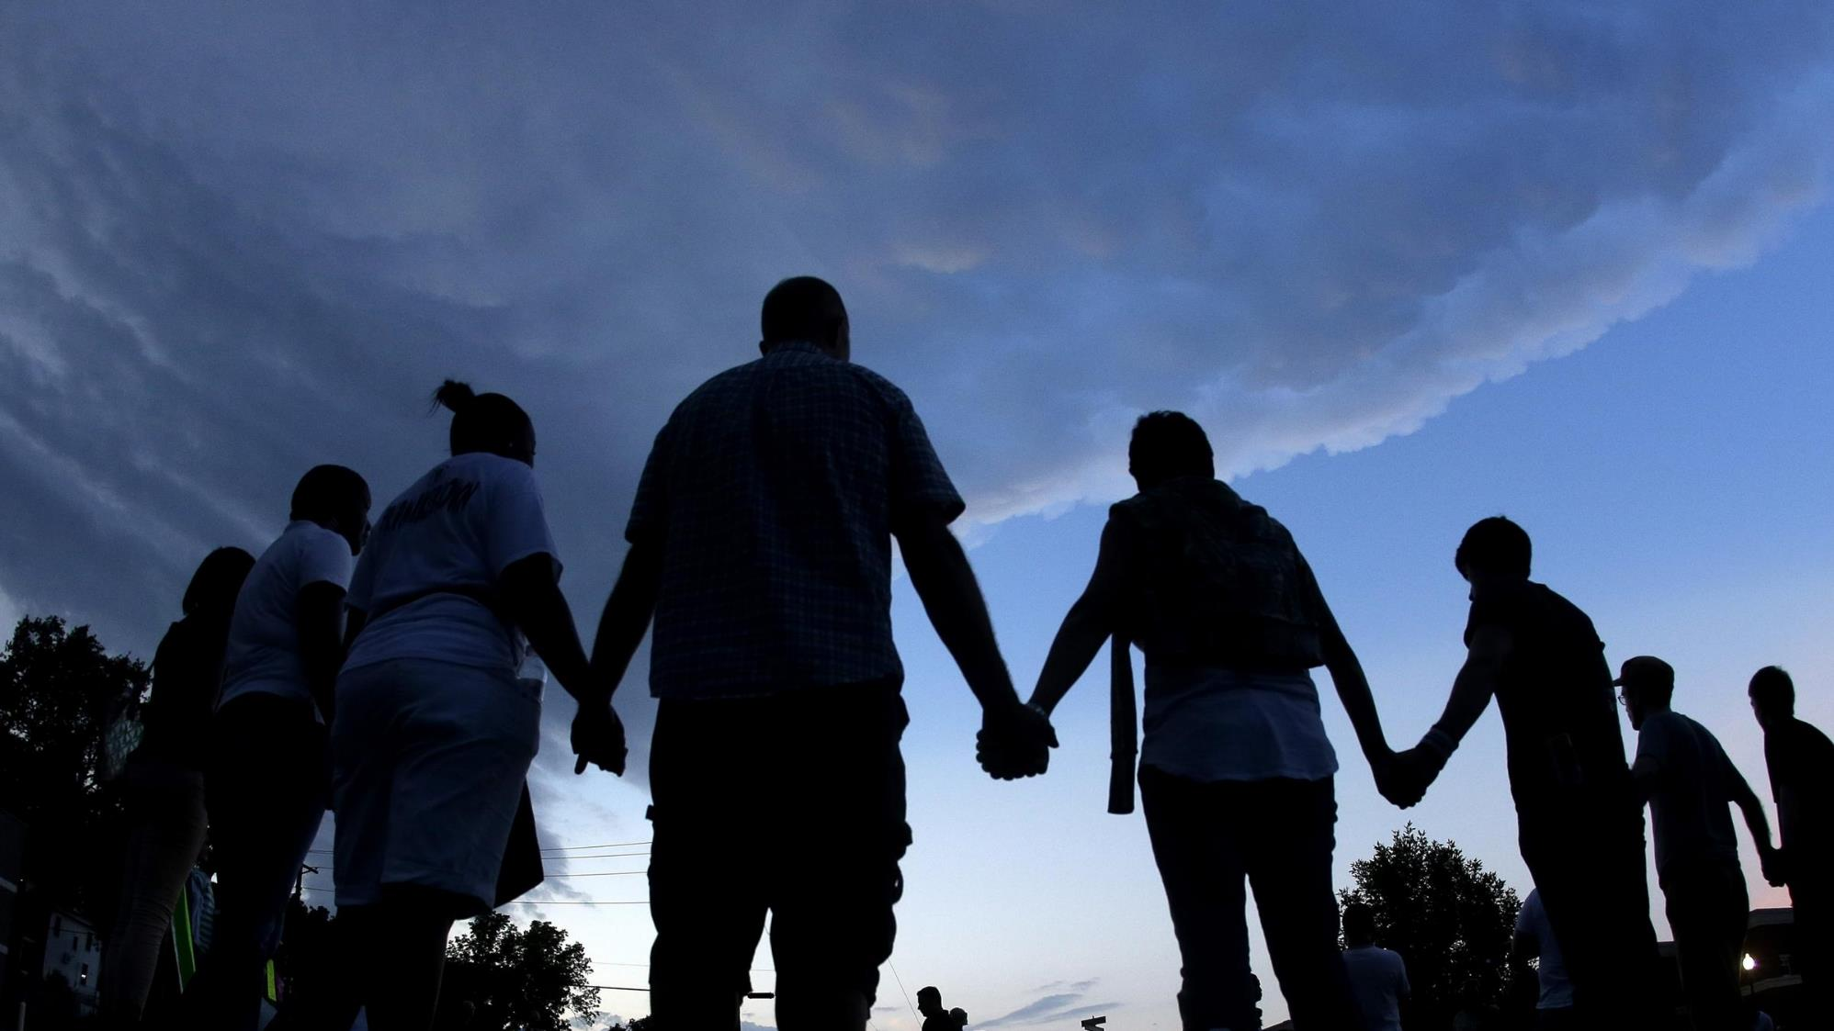
An act of renouncing and affirmation
So, in the spirit of solidarity and in the name of the rising up One, Jesus, God’s statement of fullness of life we commit, as a family, to work together to counter all that deny fullness and God’s desire for goodness.
Amen
[Adapted from CWM Publication, From the End of the World: Prayers in Defiance of Empire (Abingdon Press, 2020)]

Slide 21
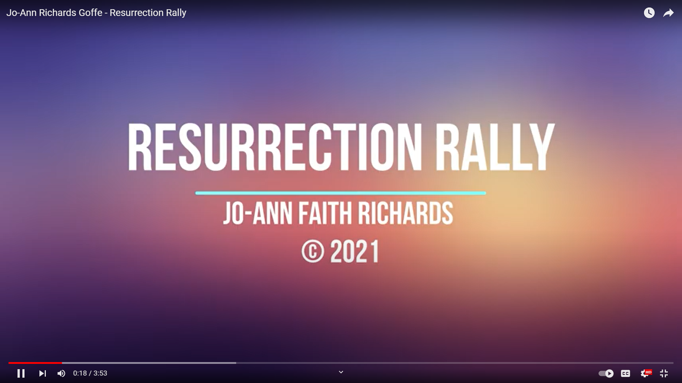
Community Singing
Resurrection Rally (Caribbean Region)
or a relevant song/hymn for your context

Slide 22
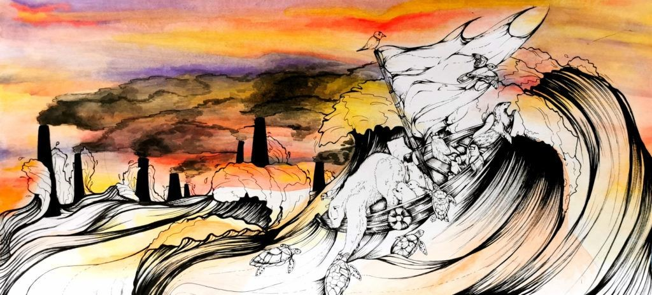
Ruo Cheng Xiao, Singapore, 2021.

Slide 23
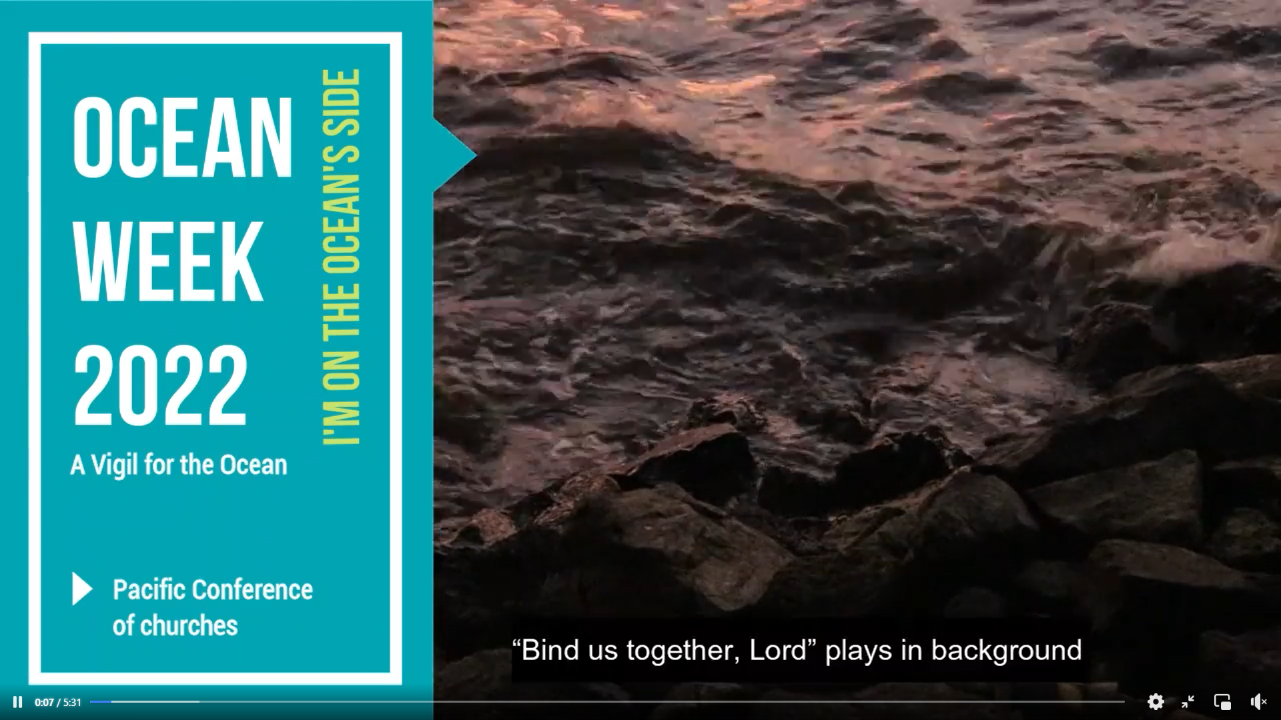

Interrupting-Challenging the flow
Here’s a Short Video Clip from the Pacific on the exploitation of the ocean, that may lead to the displacement of hundreds of thousands of people.
(Pacific Conference of Churches)

Slide 24
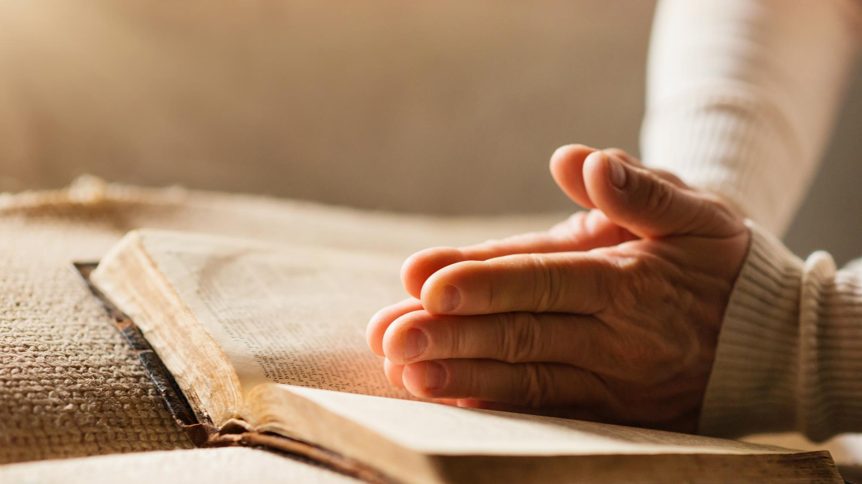
Scripture Reading
Hebrews 13: 1 – 2
“Keep on loving one another as brothers and sisters. Do not forget to show hospitality to strangers for by doing that some have shown hospitality to angels without knowing it.” May we remember today that the world’s refugees are our brothers and sisters in Christ. May we be compelled to care for them, to pray for them, to leave our doors open to them. May we be reminded that the Lord is their refuge as well, and that he is ever present with them, just as he is us.
Reflection on the above text
(member churches are invited to find and work their way through the text)

Slide 25
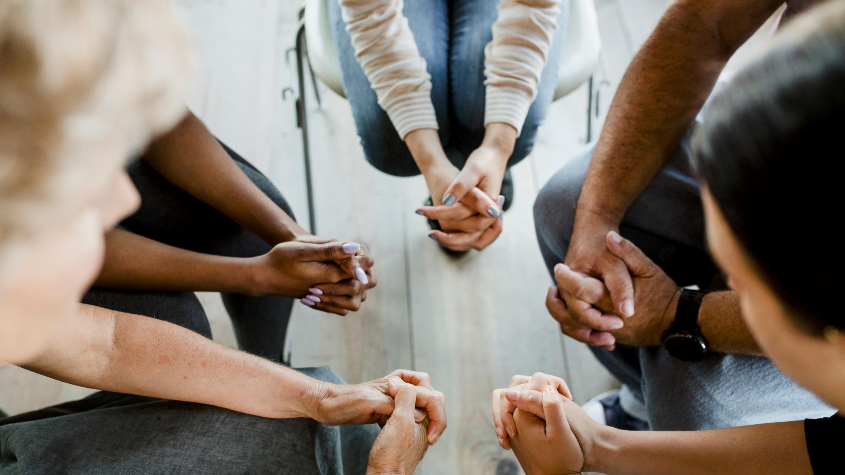
Praying for ourselves and others
Let us bring our prayers for our neighbours and ourselves to God in Christ:
Let us bring before God the economic life of these isles/this land and all its peoples: [recall fears; the sin of greed; the scandal of impoverishment.....]
You, Divine liberator, have reminded us through Christ that: “Where our treasure is, there will our hearts be”; it will profit us noting if we acquire the whole world but lose our souls”; and that the economics of your Way is different.
Hear our prayer, O God of bountiful grace

Slide 26
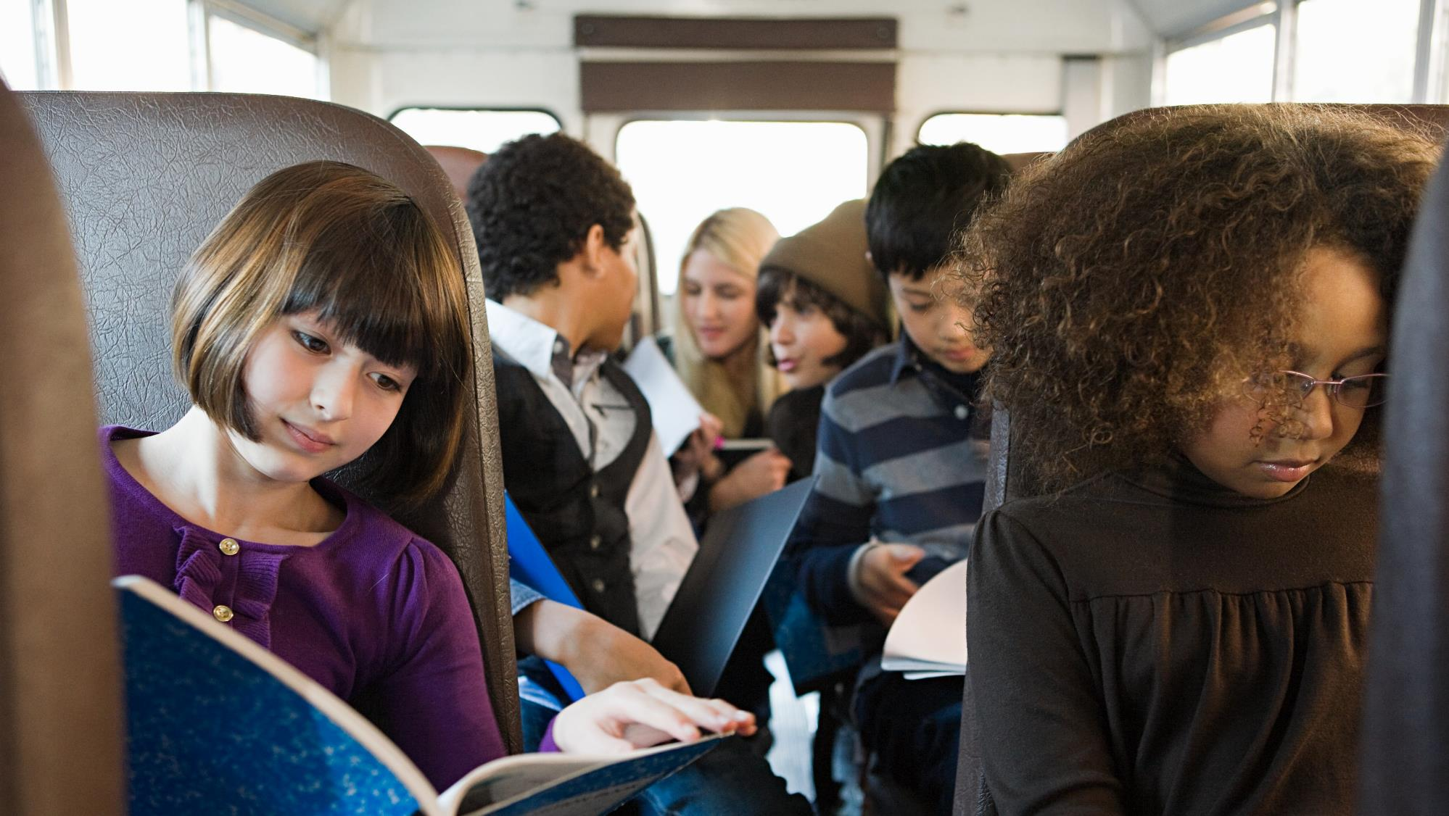
Praying for ourselves and others
Let us bring before God all the children living in fear and in situations of conflict: [pray for children of asylum seekers and refugees in detention centres or on the road or crossing waters; children around the world; for the children and young people in our own concrete jungles in our land; children robbed of their childhood by the adult world......]
You, inclusive parent, have reminded us through Christ of your love of children – signs of the Kingdom; that you bleed when they bleed and that your offer of abundant and flourishing life is for all.
Hear our prayer, O God of bountiful grace

Slide 27
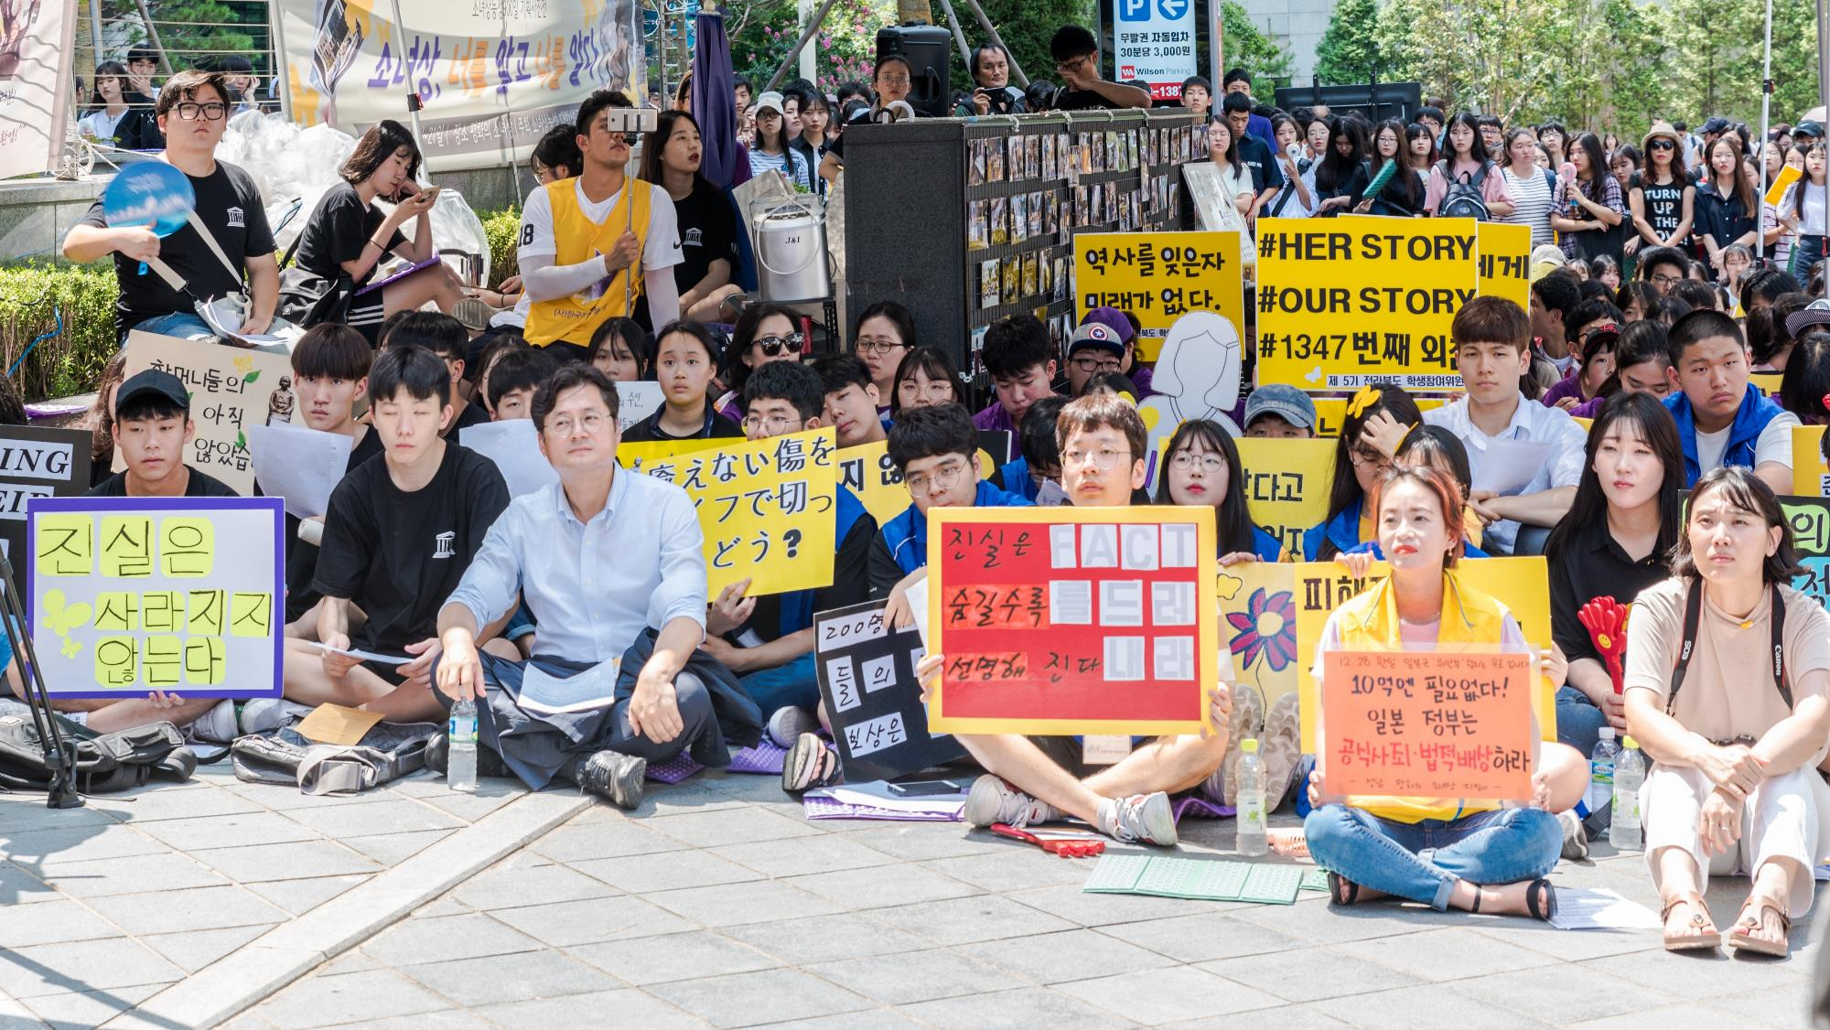
Praying for ourselves and others
Let us bring before God all in our country/land that needs protesting against and let us remember all who protest [recall recent examples of those who have protested and are protesting and what we should be protesting against starting with the examples in your own land]
You, just and protesting God, have called us through the example of Jesus, the many prophets before him and those of our time to protest until injustices crumble and society is transformed..
Hear our prayer, O God of bountiful grace

Slide 28

Praying for ourselves and others
Let us bring before God the peoples of the majority world [name the positive and transforming things happening in these countries, through South-to-South partnerships and local individuals...]
You, O Lover of the whole Universe, through Christ loved so intensely that through your giving, the power of love will always vanquish the love of power.
Hear our prayer, O God of bountiful grace, Amen.

Slide 29
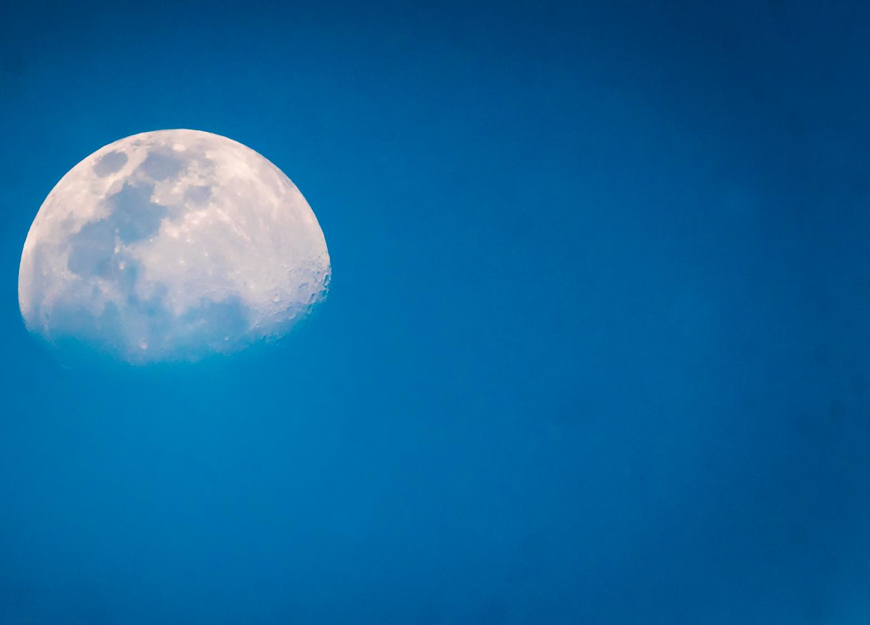
Renewing God,
active in the whole of creation,
make us receptive to your grace
that it may accomplish something new in us.
Help us to embrace new possibilities,
and empower us to imagine new ways of living your love.
Into obedient and steadfast lives,
may your Spirit yet bring a freshness
to our thoughts, words and actions,
so that we can dream new possibilities,
discern the challenges before us,
and dare to take risks in the adventure of your way

Slide 30
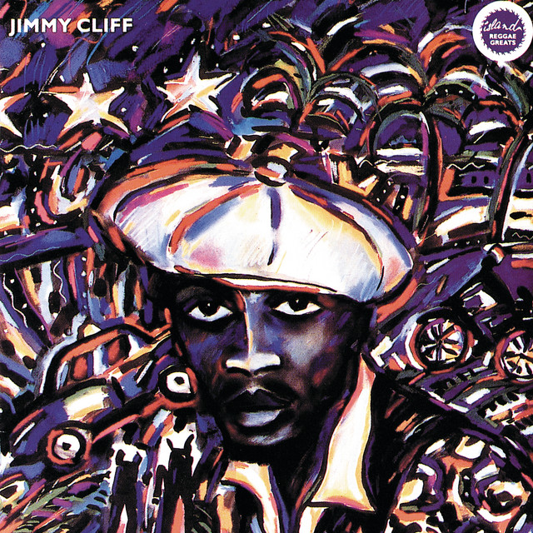
Community Singing
Many rivers to Cross – Jimmy Cliff:
or a relevant song/hymn for your context

Slide 31
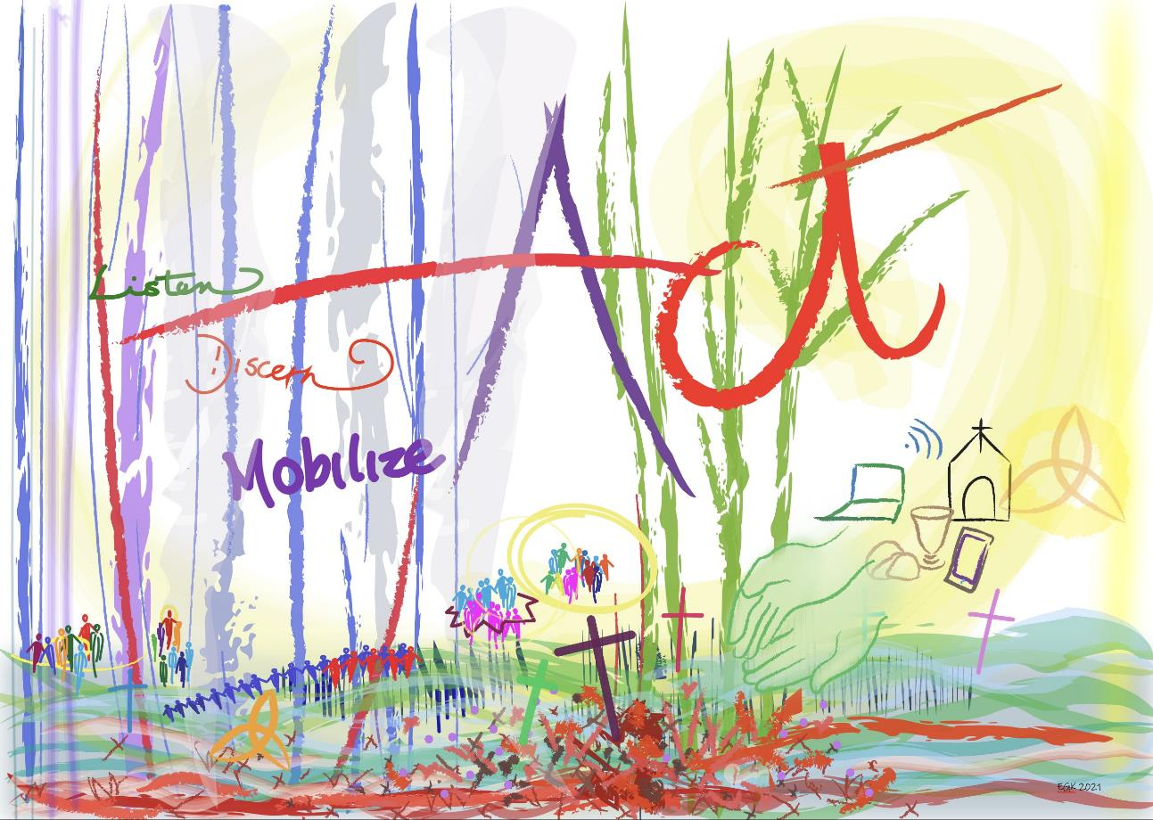
Elizabeth Gray King, Caribbean MMF 2020

Slide 32

Being Blessed, Becoming Blessings
[this can be shared by two persons]
May the One who
freed the people from slavery,
led them dry-shod through the sea,
suffered Empire’s torture and execution and
defeated the Powers ---- even the Power of death!
Free you,
lead you,
suffer with you,
and raise you;

Slide 33
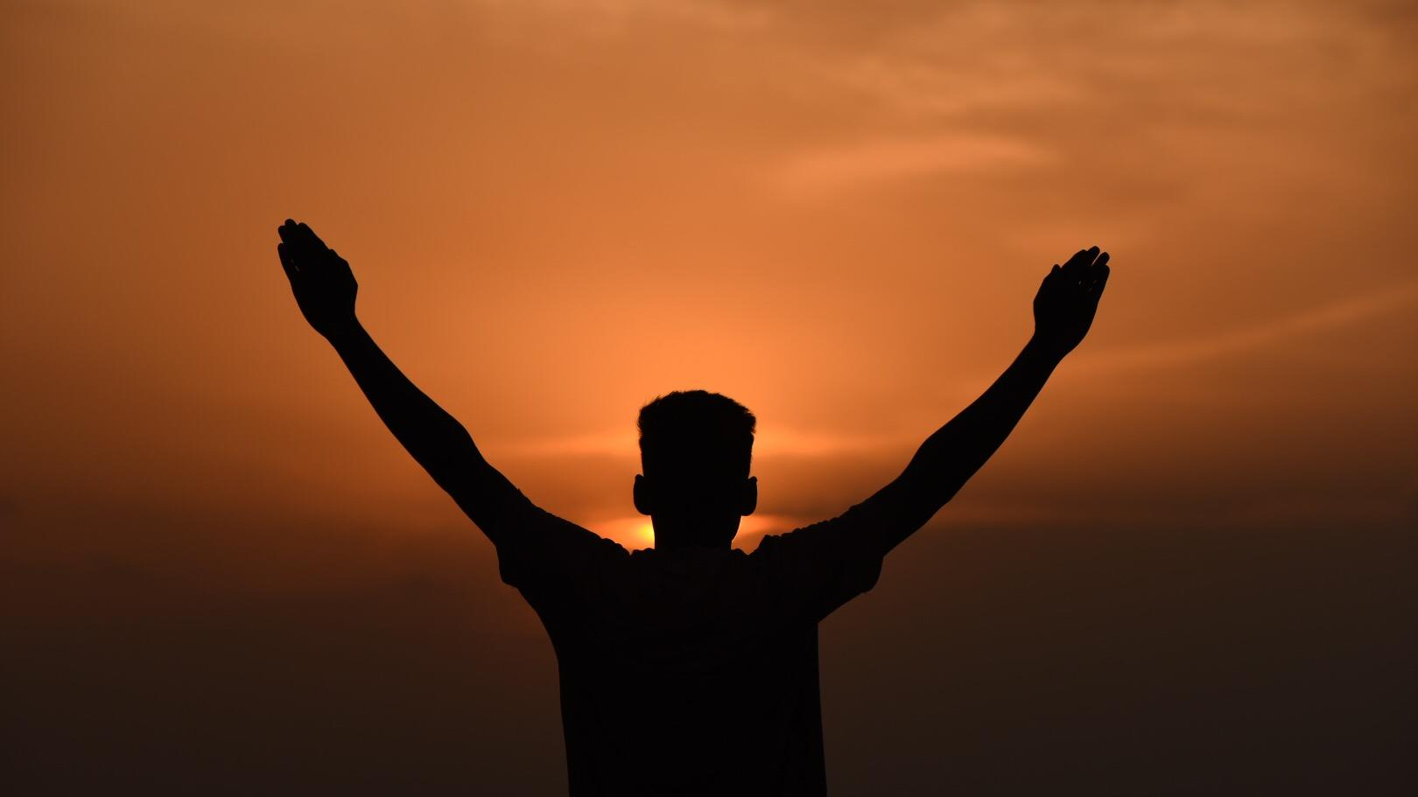
Being Blessed, Becoming Blessings
[this can be shared by two persons]
that you may use:
your weakness to be a blessing,
your hope to be a force of change,
and your audacious determination to usher in the New Age
and the blessing of Almighty God,
Father, Son and Holy Spirit
[Creator, Redeemer, and Sustainer]
be with you,
and all whom you love
now and always. Amen.
[CWM Publication, From the End of the World: Prayers in Defiance of Empire (Abingdon Press, 2020)]

